Slide 1
FDR专题
雷印如 2020/10/31

Slide 2
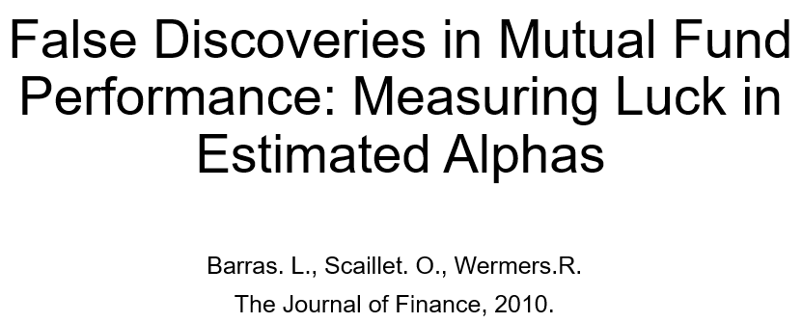
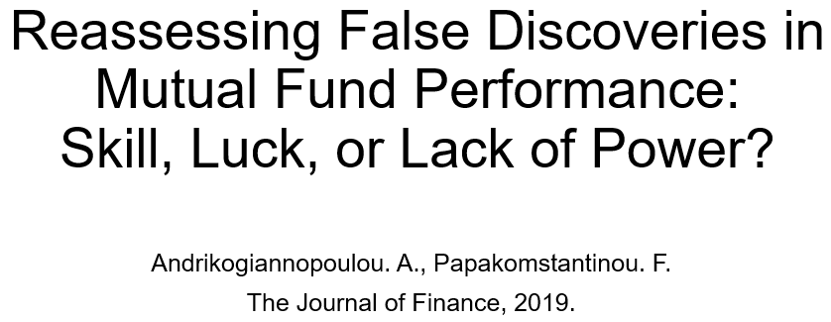


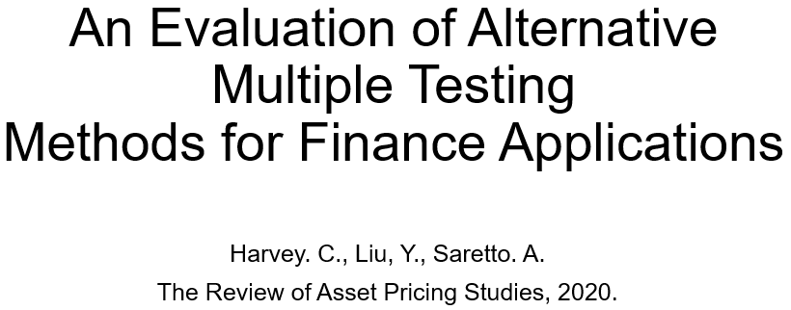
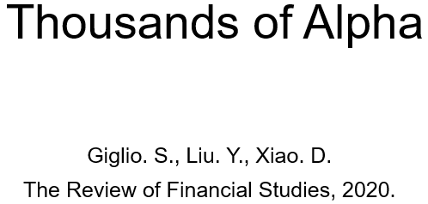
②
③
④
⑤
①
⑥

Slide 3
An Evaluation of Alternative
Multiple Testing
Methods for Finance Applications
Harvey. C., Liu, Y., Saretto. A.
The Review of Asset Pricing Studies, 2020.

Slide 4
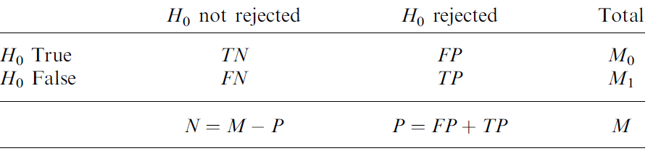
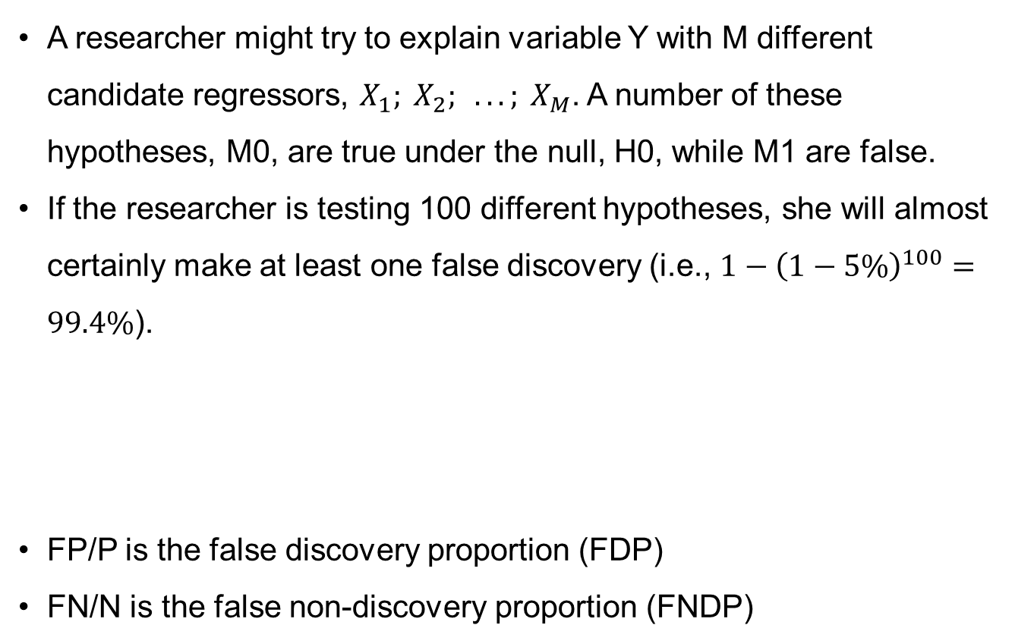
Multiple hypothesis testing (MHT)
A researcher might try to explain variable Y with M different candidate regressors, $X_{1}; X_{2}; . . . ; X_{M}$. A number of these hypotheses, M0, are true under the null, H0, while M1 are false.
If the researcher is testing 100 different hypotheses, she will almost certainly make at least one false discovery (i.e., $1−{\left(1−5\%\right)}^{100}=99.4\%$).
FP/P is the false discovery proportion (FDP)
FN/N is the false non-discovery proportion (FNDP)

Slide 5
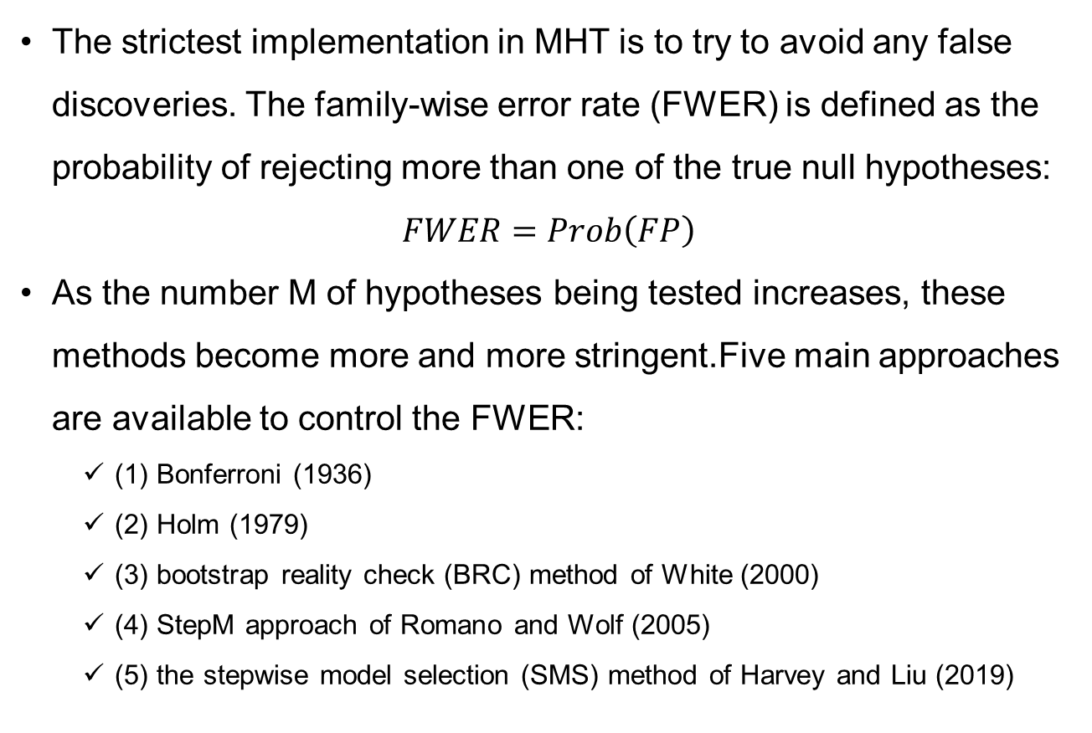
Family-wise error rate
The strictest implementation in MHT is to try to avoid any false discoveries. The family-wise error rate (FWER) is defined as the probability of rejecting more than one of the true null hypotheses:
$$FWER=Prob\left(FP\right)$$
As the number M of hypotheses being tested increases, these methods become more and more stringent.Five main approaches are available to control the FWER:
(1) Bonferroni (1936)
(2) Holm (1979)
(3) bootstrap reality check (BRC) method of White (2000)
(4) StepM approach of Romano and Wolf (2005)
(5) the stepwise model selection (SMS) method of Harvey and Liu (2019)

Slide 6
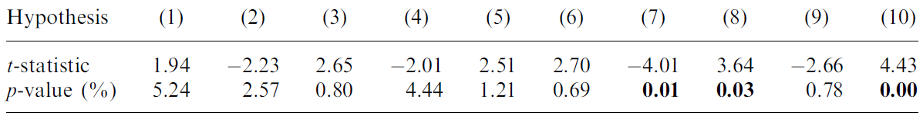
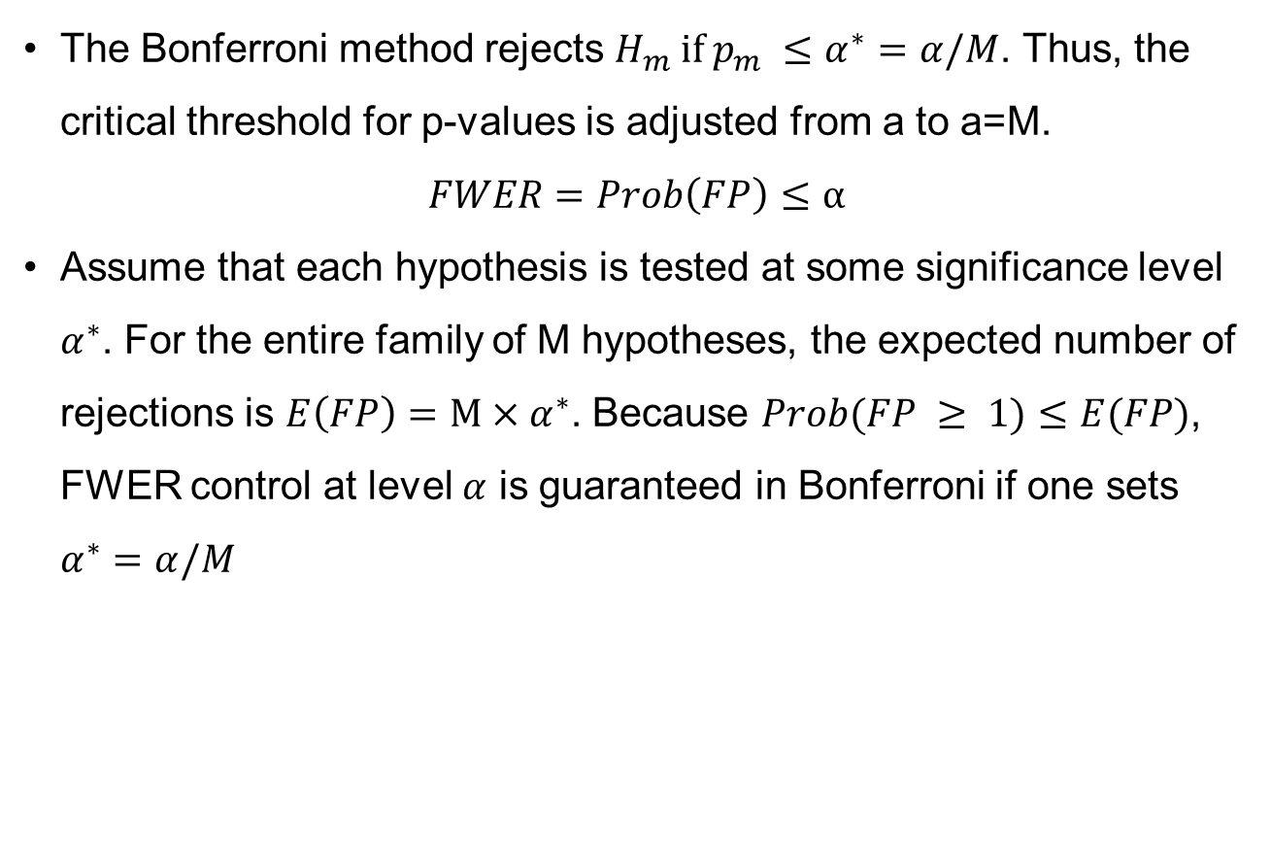
Bonferroni method
The Bonferroni method rejects $H_{m} if p_{m} ≤α^{∗}=α/M$. Thus, the critical threshold for p-values is adjusted from a to a=M.
$$FWER=Prob\left(FP\right)≤α$$
Assume that each hypothesis is tested at some significance level $α^{∗}$. For the entire family of M hypotheses, the expected number of rejections is $E\left(FP\right)=M×α^{∗}$. Because $Prob(FP ≥ 1)≤E(FP)$, FWER control at level $α$ is guaranteed in Bonferroni if one sets $α^{∗}=α/M$

Slide 7
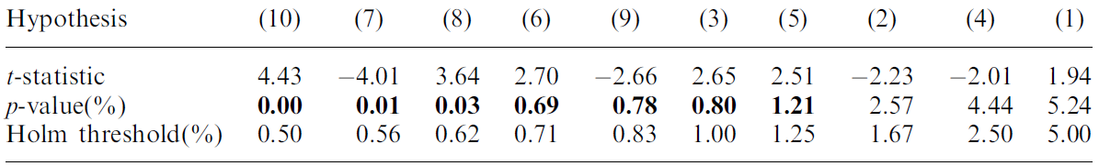
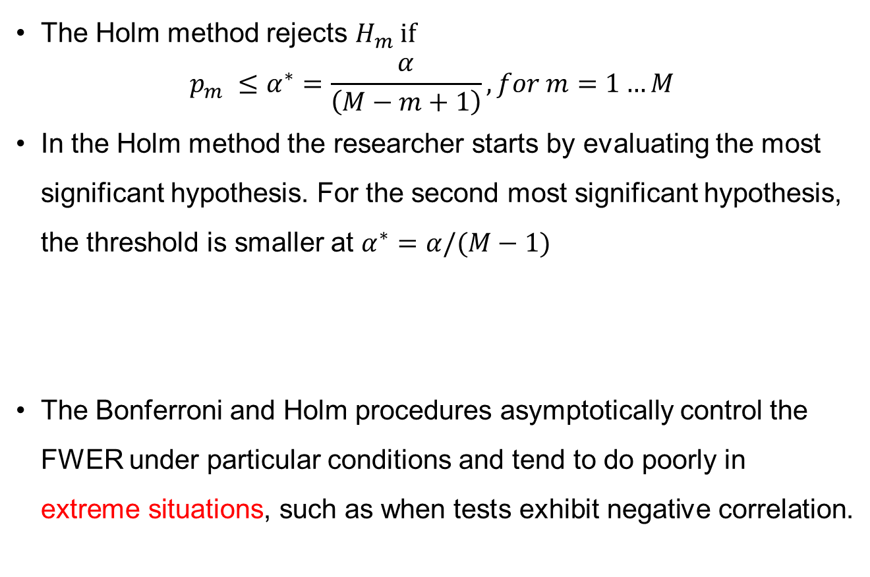
Holm method
The Holm method rejects $H_{m} if$
$$p_{m} ≤α^{∗}=\frac{α}{\left(M−m+1\right)},for m=1…M$$
In the Holm method the researcher starts by evaluating the most significant hypothesis. For the second most significant hypothesis, the threshold is smaller at $α^{∗}=α/(M−1)$
The Bonferroni and Holm procedures asymptotically control the FWER under particular conditions and tend to do poorly in extreme situations, such as when tests exhibit negative correlation.

Slide 8
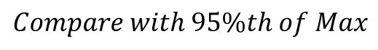
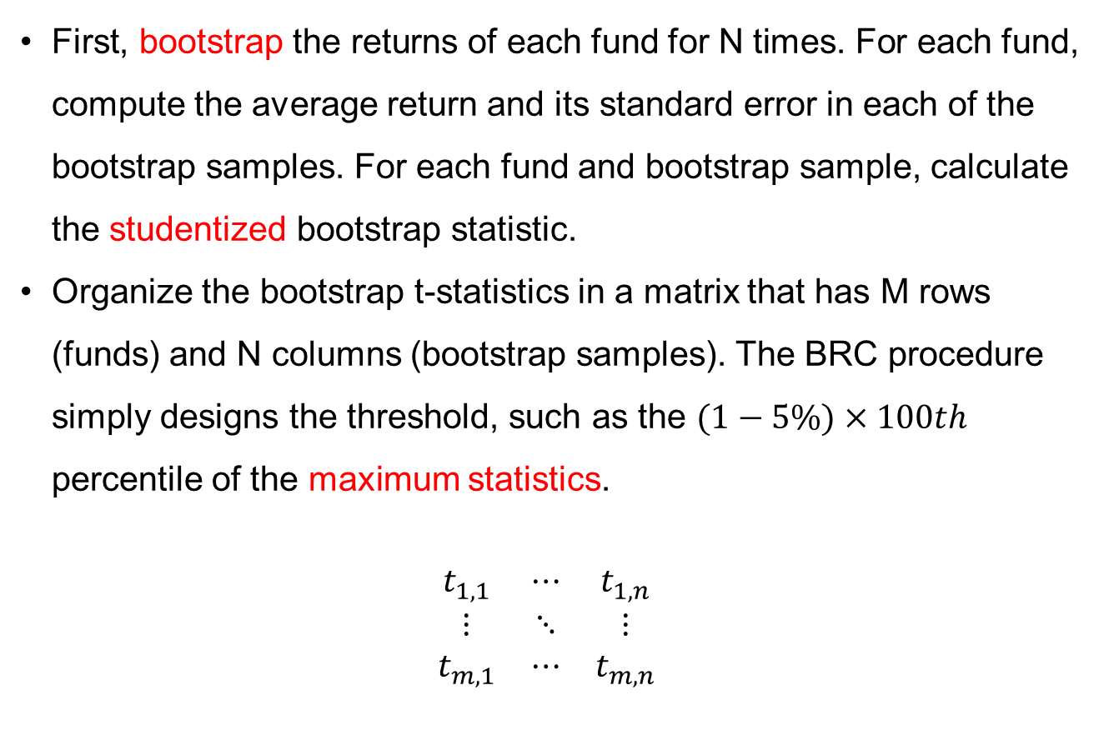
Bootstrap reality check(BRC)
First, bootstrap the returns of each fund for N times. For each fund, compute the average return and its standard error in each of the bootstrap samples. For each fund and bootstrap sample, calculate the studentized bootstrap statistic.
Organize the bootstrap t-statistics in a matrix that has M rows (funds) and N columns (bootstrap samples). The BRC procedure simply designs the threshold, such as the $(1−5\%)×100th$ percentile of the maximum statistics.
$$\begin{matrix}t_{1,1} & ⋯ & t_{1,n} \\ ⋮ & ⋱ & ⋮ \\ t_{m,1} & ⋯ & t_{m,n}\end{matrix}$$
Max
$Compare with 95\%th of Max$

Slide 9
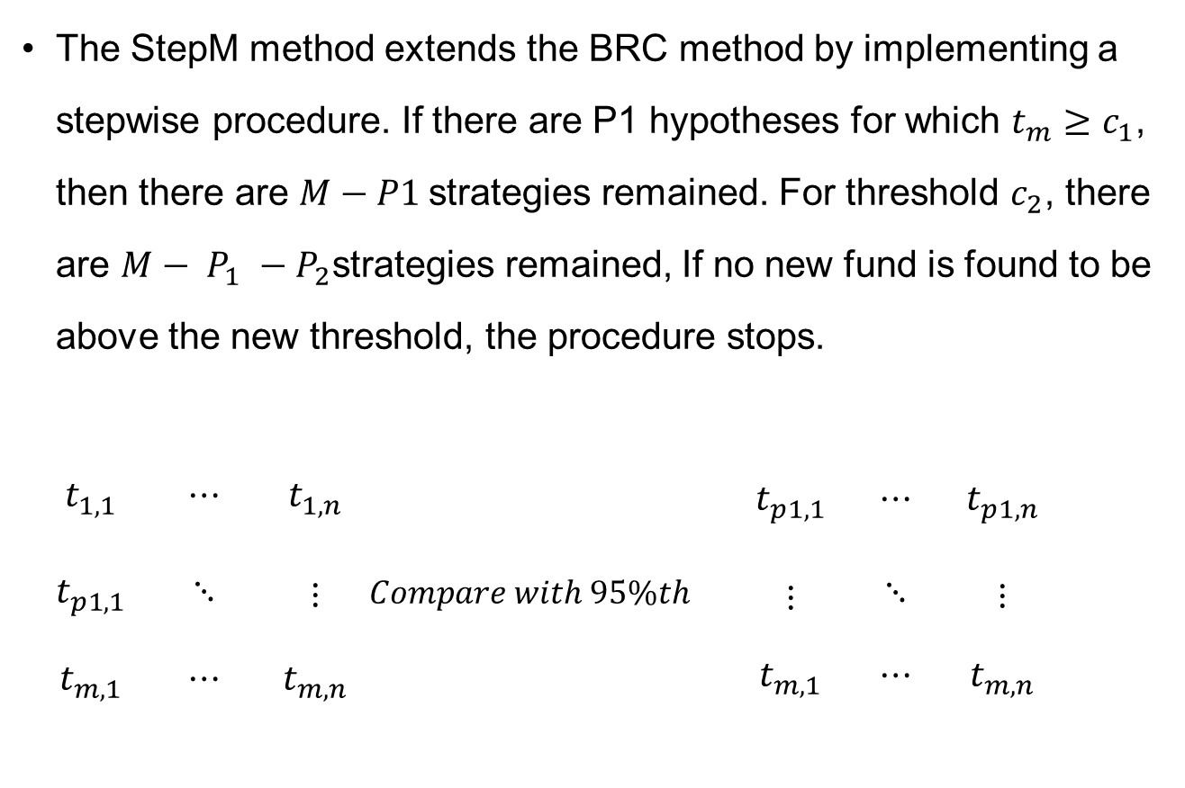
StepM method
The StepM method extends the BRC method by implementing a stepwise procedure. If there are P1 hypotheses for which $t_{m}≥c_{1}$, then there are $M−P1$strategies remained. For threshold $c_{2}$, there are $M− P_{1} −P_{2}$strategies remained, If no new fund is found to be above the new threshold, the procedure stops.
$\begin{matrix}t_{1,1} & ⋯ & t_{1,n} \\ \begin{aligned}\begin{aligned} \\ t_{p1,1}\end{aligned} \\ \end{aligned} & ⋱ & \begin{aligned} \\ ⋮ \\ \end{aligned} \\ t_{m,1} & ⋯ & t_{m,n}\end{matrix}$ $Compare with 95\%th$ $\begin{matrix}t_{p1,1} & ⋯ & t_{p1,n} \\ \begin{aligned}\begin{aligned} \\ ⋮\end{aligned} \\ \end{aligned} & ⋱ & \begin{aligned} \\ ⋮ \\ \end{aligned} \\ t_{m,1} & ⋯ & t_{m,n}\end{matrix}$
Max

Slide 10
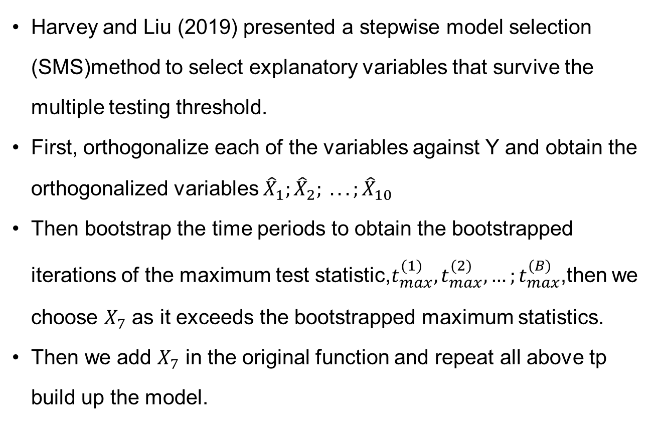
Stepwise model selection(SMS)
Harvey and Liu (2019) presented a stepwise model selection (SMS)method to select explanatory variables that survive the multiple testing threshold.
First, orthogonalize each of the variables against Y and obtain the orthogonalized variables ${\hat{X}}_{1};{\hat{X}}_{2}; . . . ;{\hat{X}}_{10}$
Then bootstrap the time periods to obtain the bootstrapped iterations of the maximum test statistic,$t_{max}^{(1)},t_{max}^{(2)},{…;t}_{max}^{(B)}$,then we choose $X_{7}$ as it exceeds the bootstrapped maximum statistics.
Then we add $X_{7}$ in the original function and repeat all above tp build up the model.

Slide 11
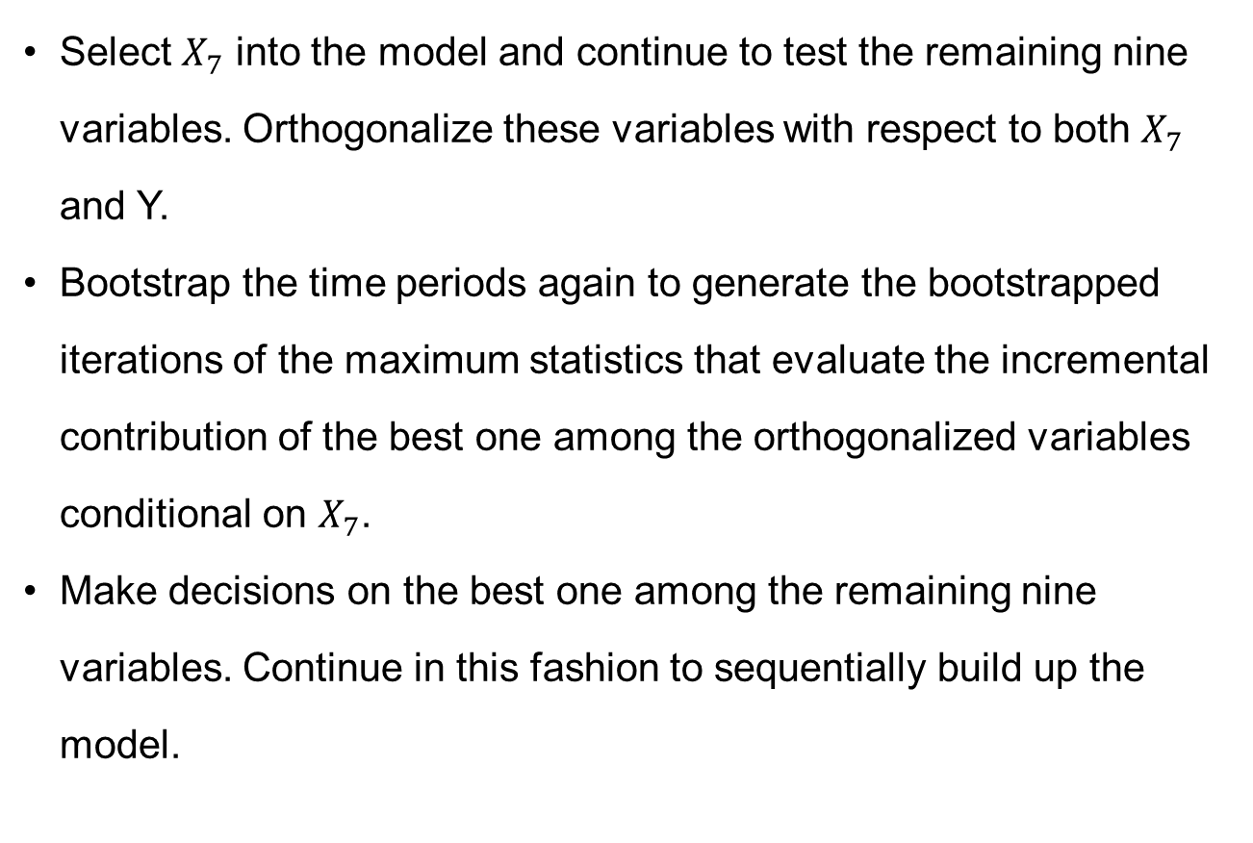
Stepwise model selection(SMS)
Select $X_{7}$ into the model and continue to test the remaining nine variables. Orthogonalize these variables with respect to both $X_{7}$ and Y.
Bootstrap the time periods again to generate the bootstrapped iterations of the maximum statistics that evaluate the incremental contribution of the best one among the orthogonalized variables conditional on $X_{7}$.
Make decisions on the best one among the remaining nine variables. Continue in this fashion to sequentially build up the model.

Slide 12
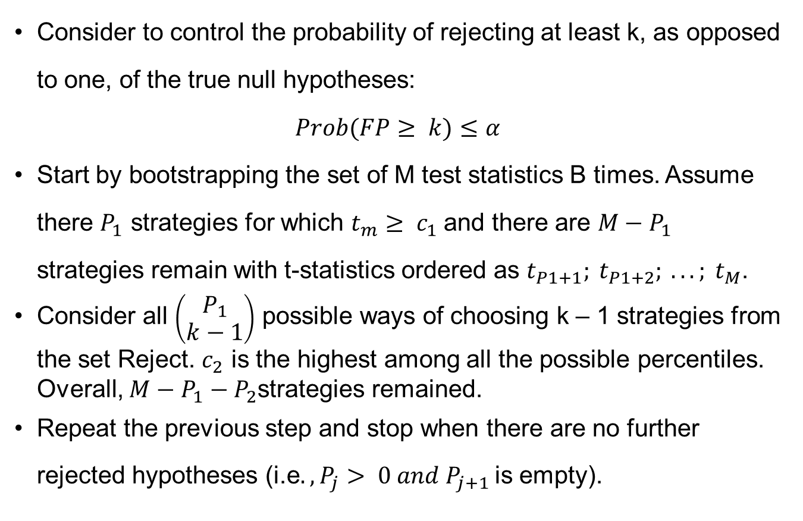
k-FWER
Consider to control the probability of rejecting at least k, as opposed to one, of the true null hypotheses:
$$Prob(FP≥ k)≤α$$
Start by bootstrapping the set of M test statistics B times. Assume there $P_{1}$ strategies for which $t_{m}≥ c_{1}$and there are $M−P_{1}$ strategies remain with t-statistics ordered as $t_{P1+1}; t_{P1+2}; . . . ; t_{M}$.
Consider all $\left(\begin{aligned}P_{1} \\ k−1\end{aligned}\right)$ possible ways of choosing k – 1 strategies from the set Reject. $c_{2}$ is the highest among all the possible percentiles. Overall, $M−P_{1}−P_{2}$strategies remained.
Repeat the previous step and stop when there are no further rejected hypotheses (i.e$., P_{j}> 0 and P_{j+1}$is empty).

Slide 13
k-FWER
FWER control is strict, as it allows at most only one false positive. As the number M of hypotheses being tested increases, these methods become more and more .In part to alleviate this concern, one can extend the concept of FWER to allow for control of any arbitrary number, k, of false rejections.
One crucial aspect of the k-StepM procedure is the fact that, at each step, the critical value is calculated by reconsidering some of the strategies that have already been rejected.
Because we do not know which were falsely rejected, Romano, Shaikh, and Wolf (2008) suggest to consider all the possible combinations of k – 1 rejected strategies.

Slide 14
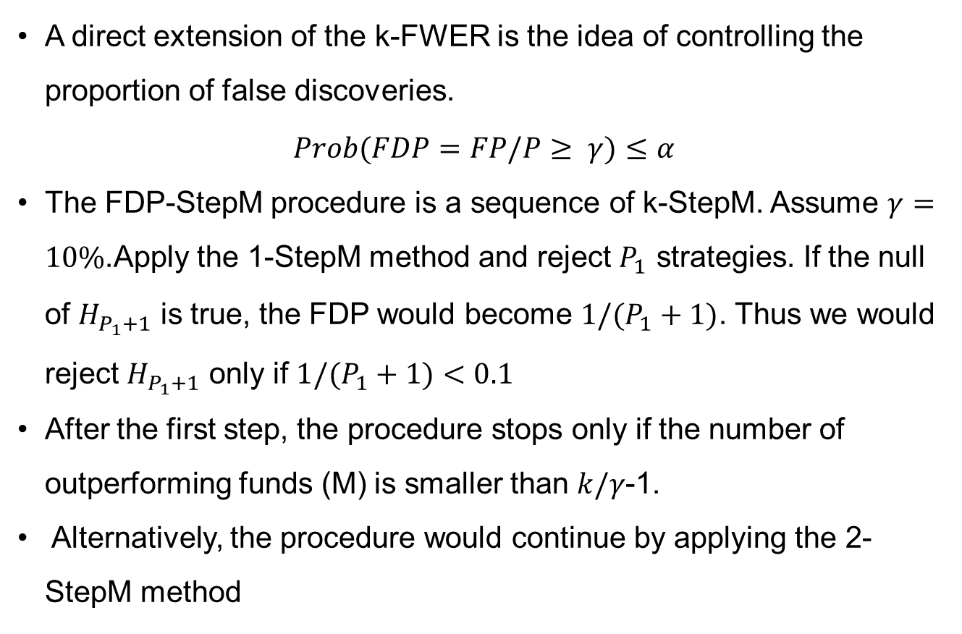
FDP-StepM (RSW)
A direct extension of the k-FWER is the idea of controlling the proportion of false discoveries.
$$Prob(FDP=FP/P≥ γ)≤α$$
The FDP-StepM procedure is a sequence of k-StepM. Assume $γ=10\%$.Apply the 1-StepM method and reject $P_{1}$ strategies. If the null of $H_{P_{1}+1}$ is true, the FDP would become $1/(P_{1}+1)$. Thus we would reject $H_{P_{1}+1}$ only if $1/(P_{1}+1)<0.1$
After the first step, the procedure stops only if the number of outperforming funds (M) is smaller than $k/γ$-1.
Alternatively, the procedure would continue by applying the 2-StepM method

Slide 15
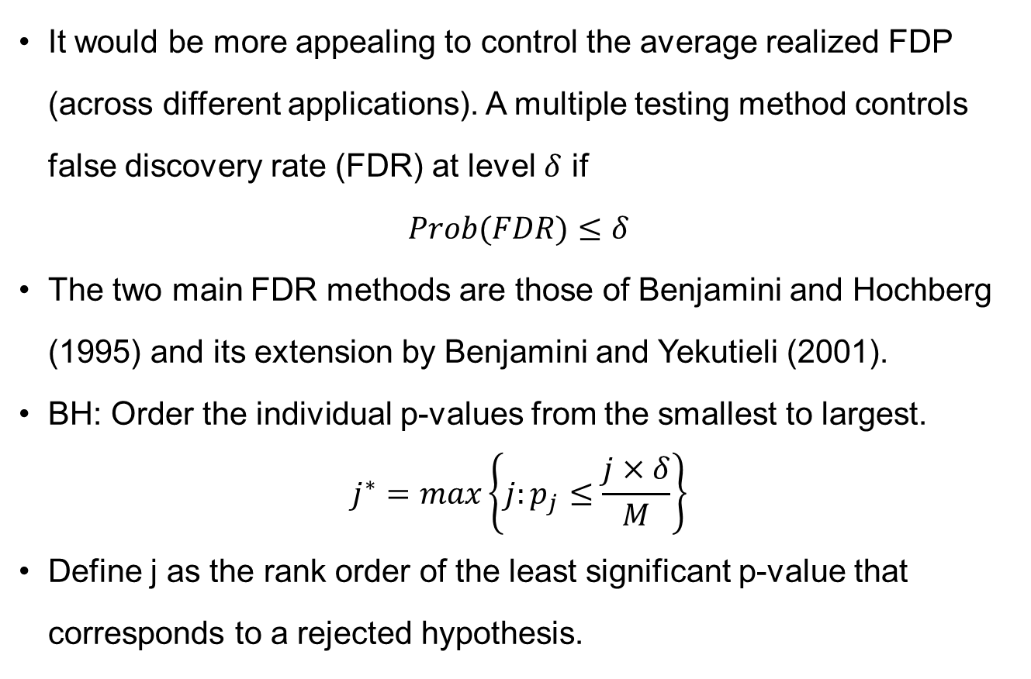
Controlling the FDR:BH
It would be more appealing to control the average realized FDP (across different applications). A multiple testing method controls false discovery rate (FDR) at level $δ$ if
$$Prob(FDR)≤δ$$
The two main FDR methods are those of Benjamini and Hochberg (1995) and its extension by Benjamini and Yekutieli (2001).
BH: Order the individual p-values from the smallest to largest.
$$j^{∗}=max\left\{j:p_{j}≤\frac{j×δ}{M}\right\}$$
Define j as the rank order of the least significant p-value that corresponds to a rejected hypothesis.

Slide 16
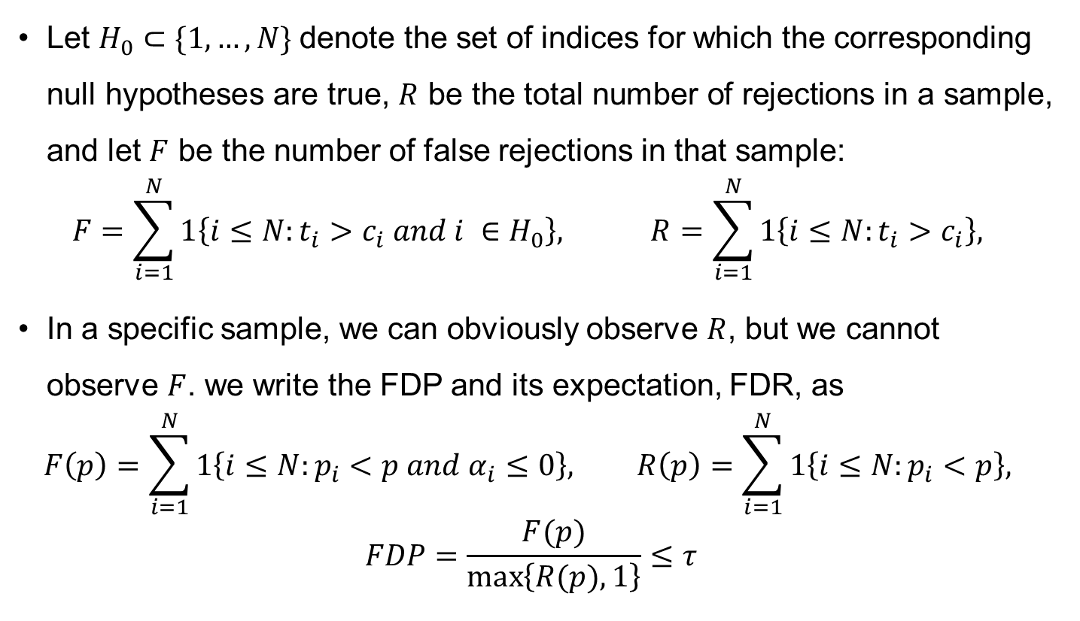
Controlling FDR
Let $H_{0}⊂\{1,…, N\}$denote the set of indices for which the corresponding null hypotheses are true, $R$ be the total number of rejections in a sample, and let $F$ be the number of false rejections in that sample:
$$F=\sum_{i=1}^{N}{1\left\{i≤N:t_{i}>c_{i} and i ∈H_{0}\right\}, } R=\sum_{i=1}^{N}{1\left\{i≤N:t_{i}>c_{i}\right\}, }$$
In a specific sample, we can obviously observe $R$, but we cannot observe $F$. we write the FDP and its expectation, FDR, as
$$F\left(p\right)=\sum_{i=1}^{N}{1\left\{i≤N:p_{i}<p and α_{i}≤0\right\}, R\left(p\right)=\sum_{i=1}^{N}{1\left\{i≤N:p_{i}<p\right\}, }}$$
$$FDP=\frac{F(p)}{\max\left\{R(p),1\right\}}≤τ$$

Slide 17
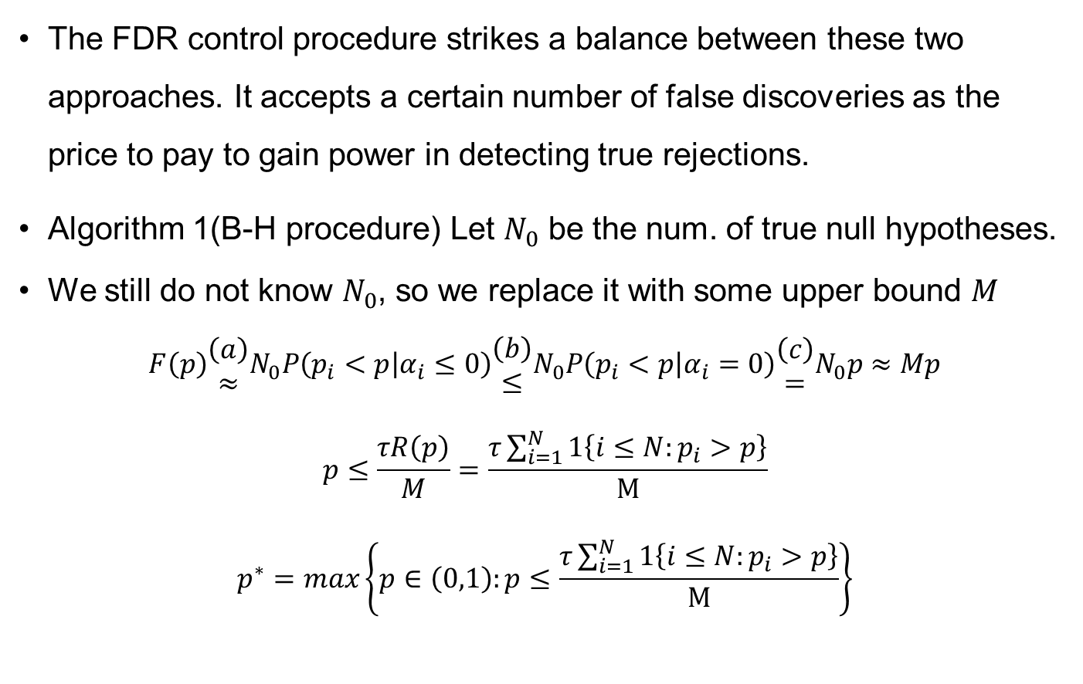
B-H procedure
The FDR control procedure strikes a balance between these two approaches. It accepts a certain number of false discoveries as the price to pay to gain power in detecting true rejections.
Algorithm 1(B-H procedure) Let $N_{0}$ be the num. of true null hypotheses.
We still do not know $N_{0}$, so we replace it with some upper bound $M$
$$F\left(p\right)\begin{matrix}\left(a\right) \\ ≈\end{matrix}N_{0}P\left(p_{i}<p | α_{i}≤0\right)\begin{matrix}\left(b\right) \\ ≤\end{matrix}N_{0}P\left(p_{i}<p | α_{i}=0\right)\begin{matrix}\left(c\right) \\ =\end{matrix}N_{0}p≈Mp$$
$$p≤\frac{τR\left(p\right)}{M}=\frac{τ\sum_{i=1}^{N}{1\left\{i≤N:p_{i}>p\right\}}}{M}$$
$$p^{∗}=max\left\{p∈\left(0,1\right):p≤\frac{τ\sum_{i=1}^{N}{1\left\{i≤N:p_{i}>p\right\}}}{M}\right\}$$

Slide 18
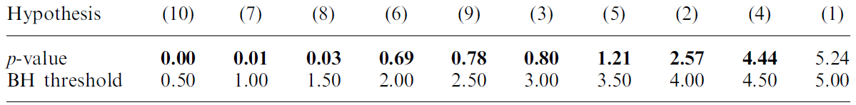
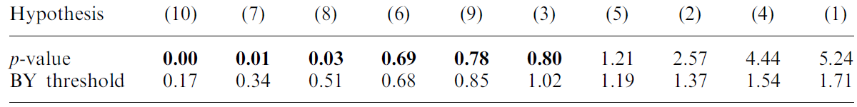
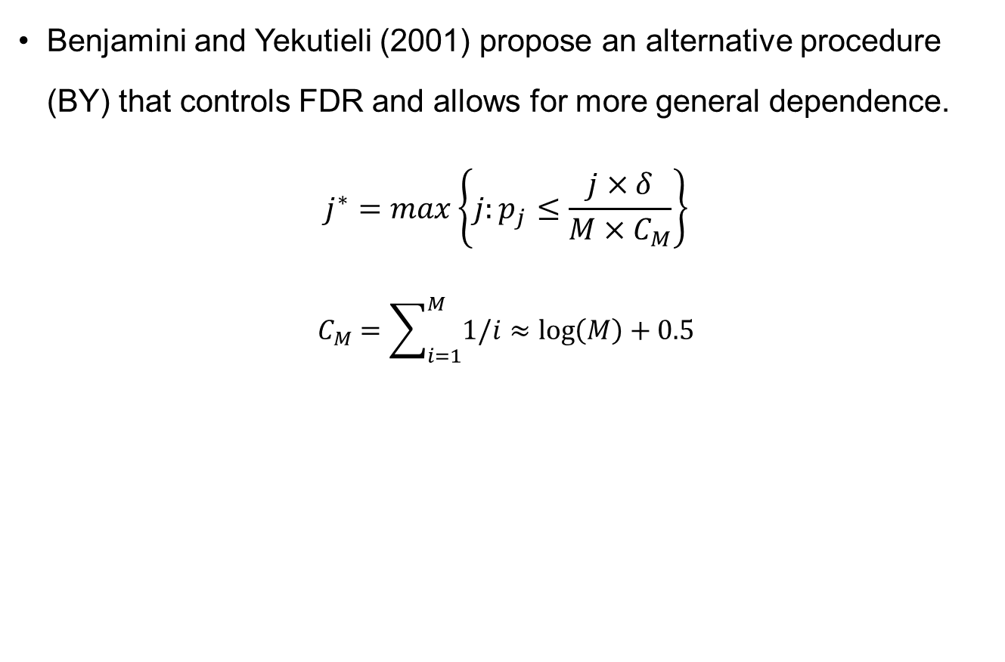
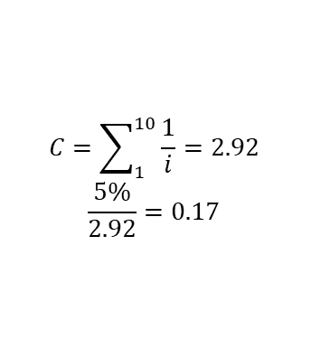
Controlling the FDR:BY
Benjamini and Yekutieli (2001) propose an alternative procedure (BY) that controls FDR and allows for more general dependence.
$$j^{∗}=max\left\{j:p_{j}≤\frac{j×δ}{M×C_{M}}\right\}$$
$$C_{M}=\sum_{i=1}^{M}{1/i≈\log\left(M\right)+0.5}$$
$$C=\sum_{1}^{10}{\frac{1}{i}=2.92}$$
$$\frac{5\%}{2.92}=0.17$$

Slide 19
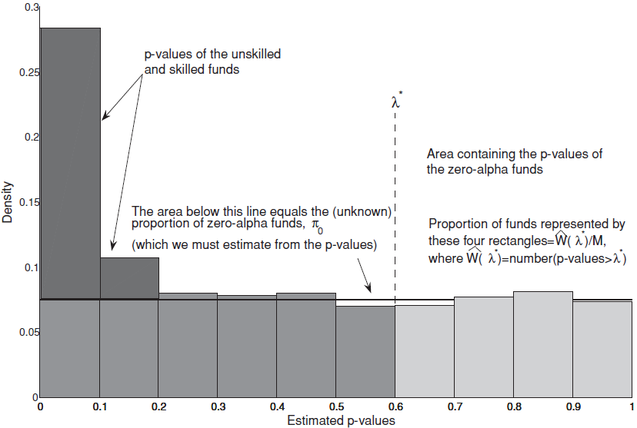
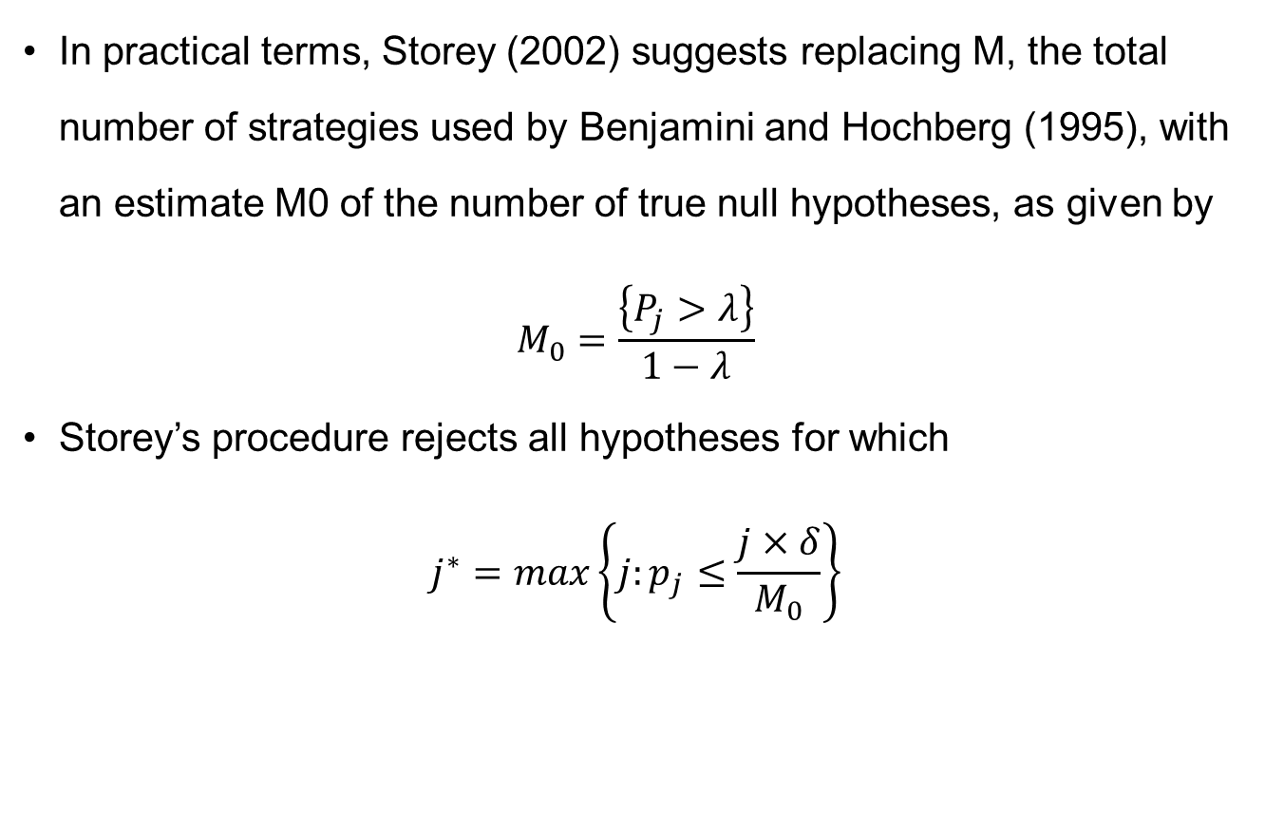
Extension of BHY
In practical terms, Storey (2002) suggests replacing M, the total number of strategies used by Benjamini and Hochberg (1995), with an estimate M0 of the number of true null hypotheses, as given by
$$M_{0}=\frac{\left\{P_{j}>λ\right\}}{1−λ}$$
Storey’s procedure rejects all hypotheses for which
$$j^{∗}=max\left\{j:p_{j}≤\frac{j×δ}{M_{0}}\right\}$$

Slide 20
Recent developments
A number of ways are available for introducing weights.
Benjamini and Hochberg (1997) formalized the idea of weighing each rejection by a positive constant.
Benjamini and Bogomolov (2014) proposed reducing the number of hypotheses that are considered by eliminating groups of hypotheses that are likely true under the null
Basu et al. (2018) introduced a procedure in which weights are assigned to all hypotheses tested, not just those that are falsely rejected.
Harvey and Liu (2020) proposed a procedure that flexibly estimates both Type I and Type II error rates.

Slide 21
Bayesian approaches
Bayesian methods have been developed to address the multiple testing issue. The Bayesian posterior probabilities automatically adjust for simultaneous tests of many factors or managers.
Several hurdles exist for successfully applying Bayesian methods to the MHT problem. Bayesian solutions are also much more challenging to obtain compared with the aforementioned frequentist methods. Finally, test correlations are more difficult to incorporate for Bayesian approaches than for certain frequentist methods.
Given these concerns, in this paper we primarily focus on the frequentist approach.

Slide 22
Finance Applications
Lo and MacKinlay (1990)made a first attempt to quantify the data snooping bias in asset pricing applications.
Recently, a number of researchers have published papers in which they have applied some of these methods to address questions about either fund performance or the statistical significance of trading strategies constructed by sorting stocks based on a certain signal (i.e., anomalies and factors).

Slide 23
Fund performance
Barras, Scaillet, and Wermers (2010) apply the FDR procedure of Storey (2002) to quantify the empirical null. They find a very small percentage (i.e., 0.8%) of fund managers who exhibit some skill.
Andrikogiannopoulou and Papakonstantinou (2019) and BSW (2019) find that low power and parameter uncertainty are largely responsible for overestimating the empirical null and for underestimating the proportion of funds with positive alphas.
Harvey and Liu (2020) propose a new procedure that can aid in situations when power is a concern by balancing the control of false discoveries and false non-discoveries.

Slide 24
Long-short portfolios
Harvey, Liu, and Zhu (2016) showed that many factors are likely false even when MHT adjustments are applied exclusively to the set of published discoveries, MHT corrections would be even stricter and lead to a higher proportion of false discoveries.
Chordia, Goyal, and Saretto (2020) offer evidence, based on over two million trading strategies, that is consistent with this observation.
The application of MHT to factors is particularly interesting given that hundreds of academic papers propose factors and over 1,000 investment products implement these ideas.

Slide 25
Other settings
The MHT problem exists in many other settings, interestingly, even in situations when exogenous variation in the data is used to bolster the interpretation of an effect as a causal relationship(List, Shaikh, and Xu, 2019; Romano and Wolf, 2010; Heath et al., 2019 and Romano and Wolf, 2005)

Slide 26
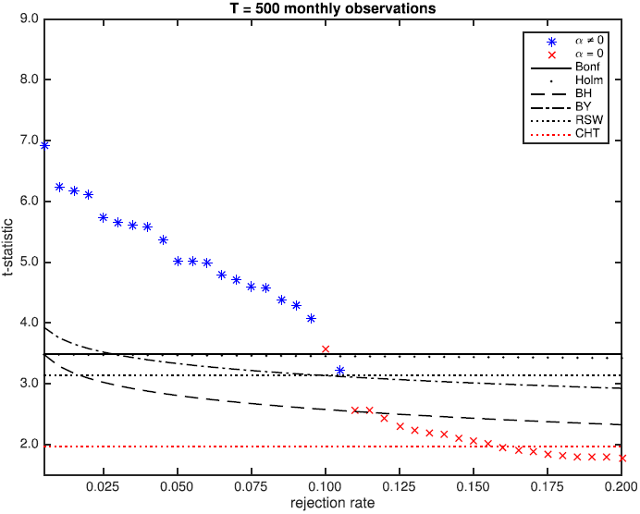
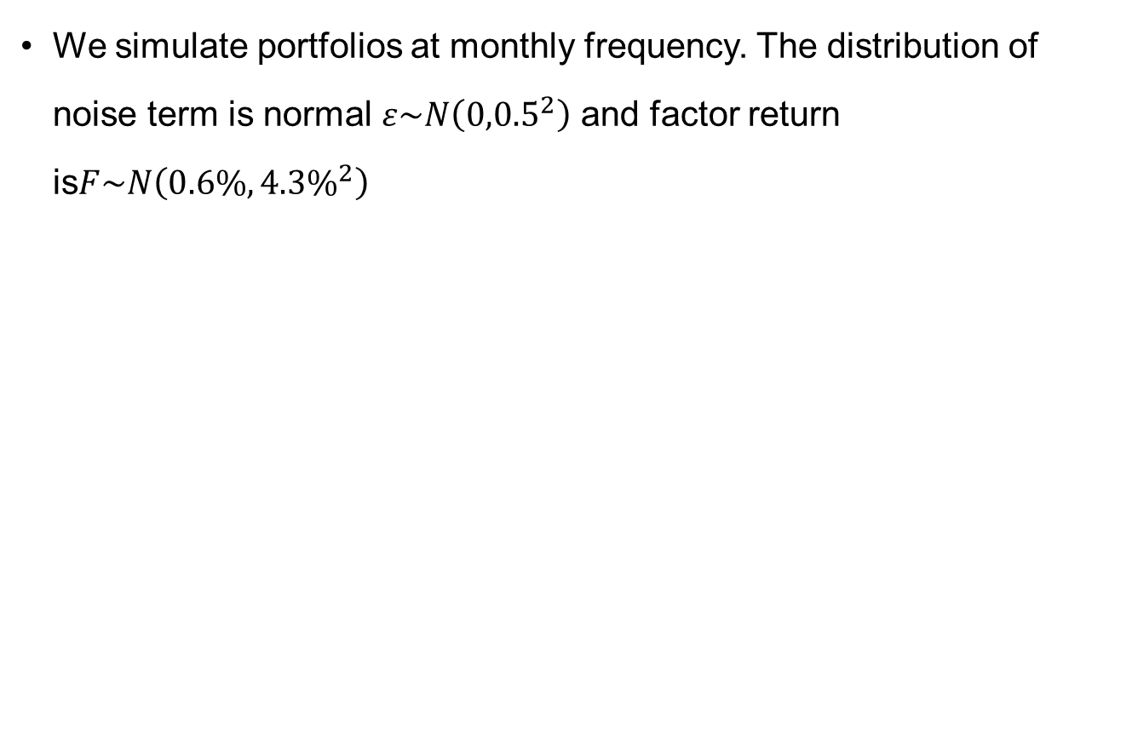
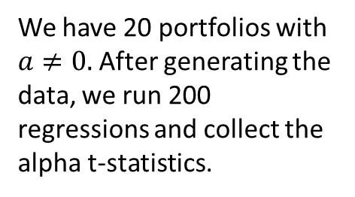
Simulation
We simulate portfolios at monthly frequency. The distribution of noise term is normal $ε\sim N\left({0,0.5}^{2}\right)$ and factor return is$F\sim N\left({0.6\%,4.3\%}^{2}\right)$
We have 20 portfolios with $a≠0.$After generating the data, we run 200 regressions and collect the alpha t-statistics.

Slide 27
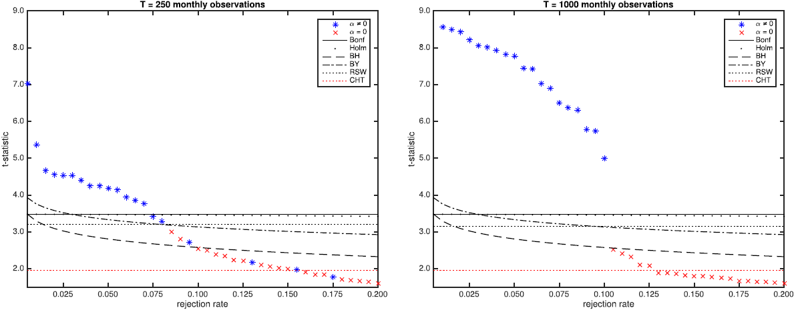
Simulation
Increasing the number of observations, which leads to increased power, has a big effect on the MHT procedures. When T is large, there is enough power to estimate alphas, and all MHT become accurate and reject all hypotheses that should be rejected

Slide 28
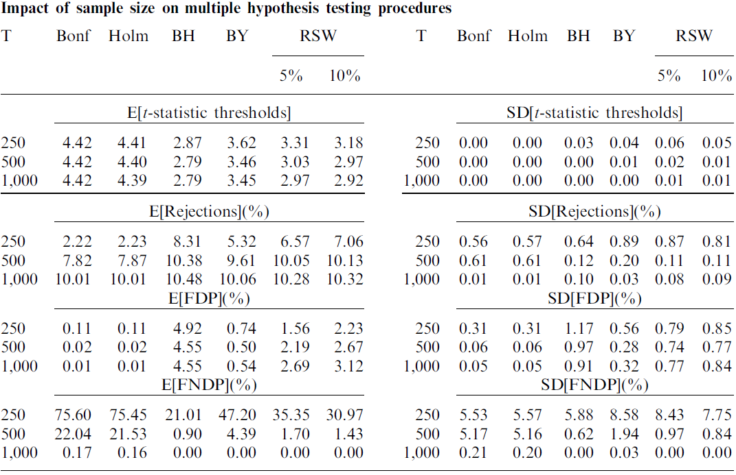
Sample size and signal to noise
If power is high as a result of a large number of observations or the signal-to-noise ratio is high, then it is easier to separate hypotheses with a true nonzero alpha from hypotheses with a true zero alpha.

Slide 29
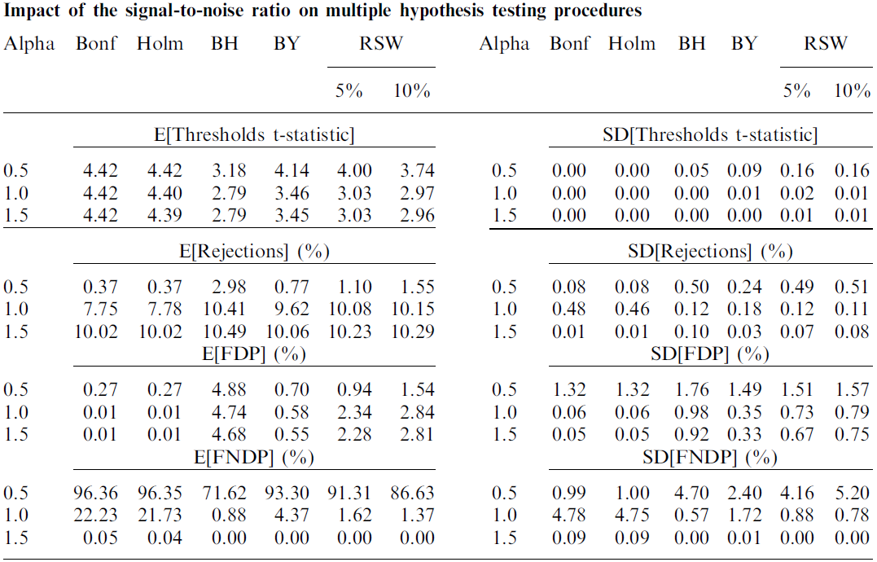
Sample size and signal to noise
If power is high as a result of a large number of observations or the signal-to-noise ratio is high, then it is easier to separate hypotheses with a true nonzero alpha from hypotheses with a true zero alpha.

Slide 30
Sample size and signal to noise
When power is very high, the variation in t-statistic thresholds across simulations becomes very small.
As shown in both Tables 2 and 3, the biggest impact of increasing power is on the FNDP for which we observe a decrease in both average and standard deviation when moving from low to high power for all procedures

Slide 31
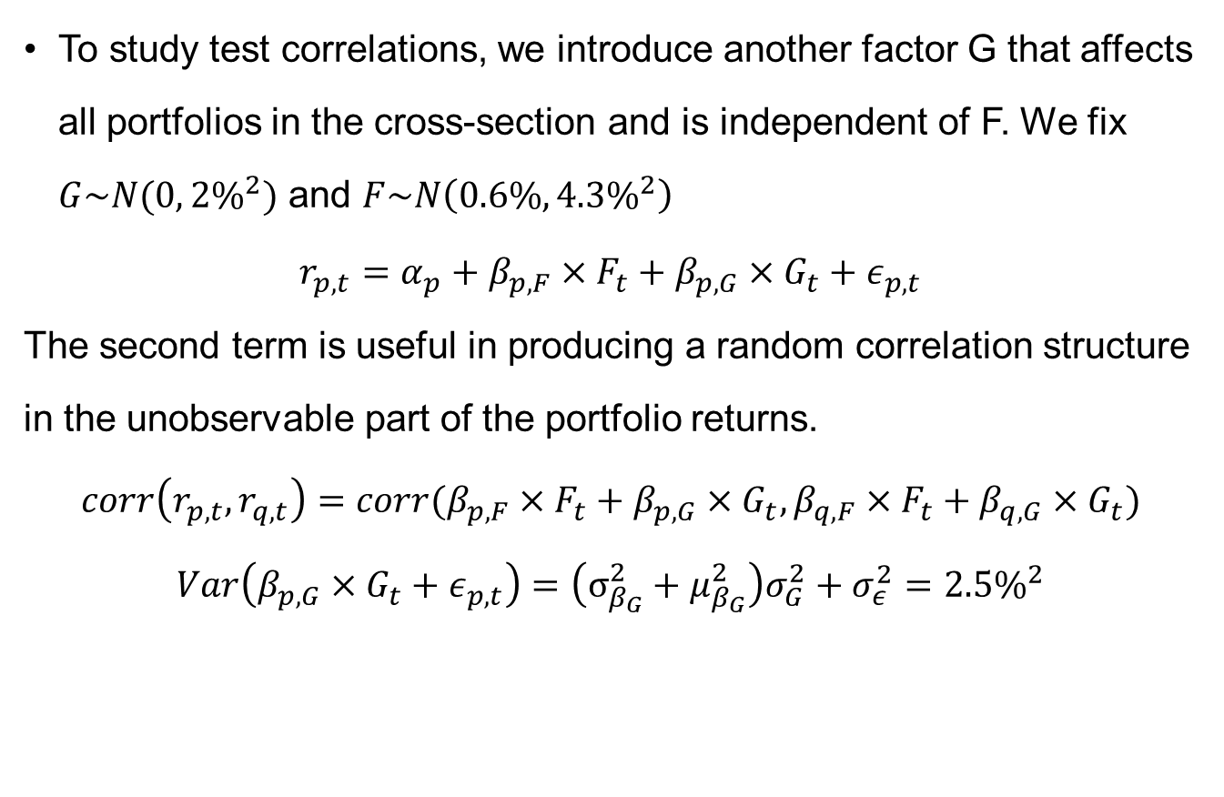
Correlation
To study test correlations, we introduce another factor G that affects all portfolios in the cross-section and is independent of F. We fix $G\sim N(0, 2\%^{2})$ and $F\sim N\left({0.6\%,4.3\%}^{2}\right)$
$$r_{p,t}=α_{p}+β_{p,F}×F_{t}+β_{p,G}×G_{t}+ε_{p,t}$$
The second term is useful in producing a random correlation structure in the unobservable part of the portfolio returns.
$$corr\left(r_{p,t},r_{q,t}\right)=corr(β_{p,F}×F_{t}+β_{p,G}×G_{t},β_{q,F}×F_{t}+β_{q,G}×G_{t})$$
$$Var\left(β_{p,G}×G_{t}+ε_{p,t}\right)=\left(σ_{β_{G}}^{2}+μ_{β_{G}}^{2}\right)σ_{G}^{2}+σ_{ε}^{2}=2.5\%^{2}$$

Slide 32
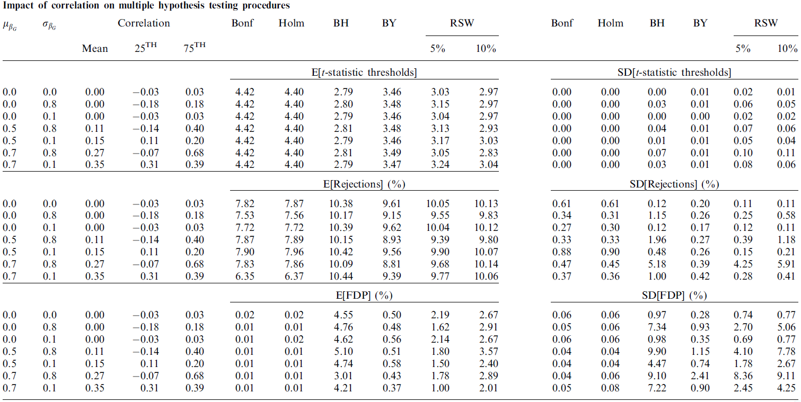
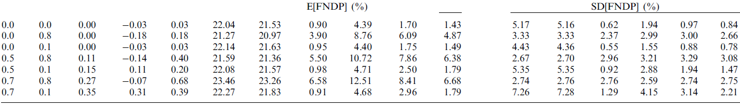
Correlation
Focusing on BH and BY, we find that the FDR in general decreases when correlations are on average high. Correspondingly, the expected false non discovery rate increases.

Slide 33
Correlation
Focusing on BH and BY, we find that the FDR in general decreases when correlations are on average high. Correspondingly, the expected false non discovery rate increases.
On the other hand, dispersion in correlation also seems to have a significant impact on error rates.
An increase in the dispersion of correlations substantially increases the standard deviation of the FDP. Methods with more stringent thresholds (e.g., Bonferroni and Holm) have a much smaller variation in FDP.

Slide 34
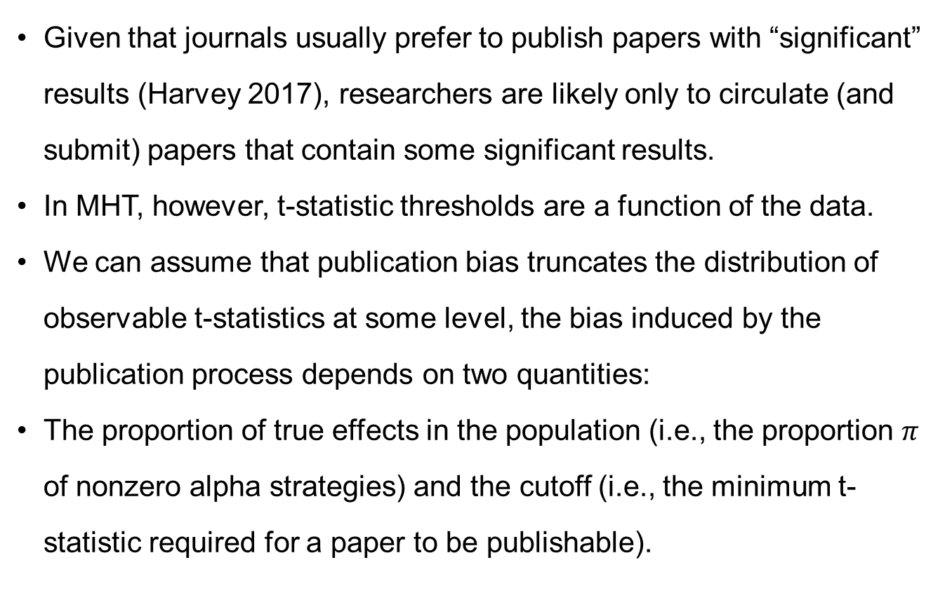
Publication bias
Given that journals usually prefer to publish papers with “significant” results (Harvey 2017), researchers are likely only to circulate (and submit) papers that contain some significant results.
In MHT, however, t-statistic thresholds are a function of the data.
We can assume that publication bias truncates the distribution of observable t-statistics at some level, the bias induced by the publication process depends on two quantities:
The proportion of true effects in the population (i.e., the proportion $π$ of nonzero alpha strategies) and the cutoff (i.e., the minimum t-statistic required for a paper to be publishable).

Slide 35
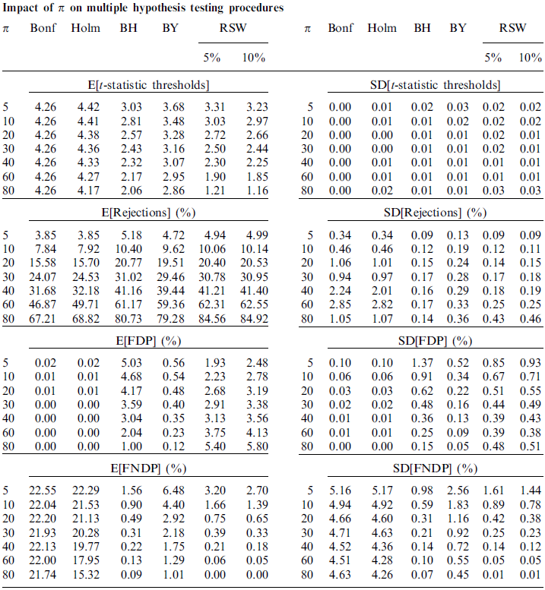
Publication bias

Slide 36
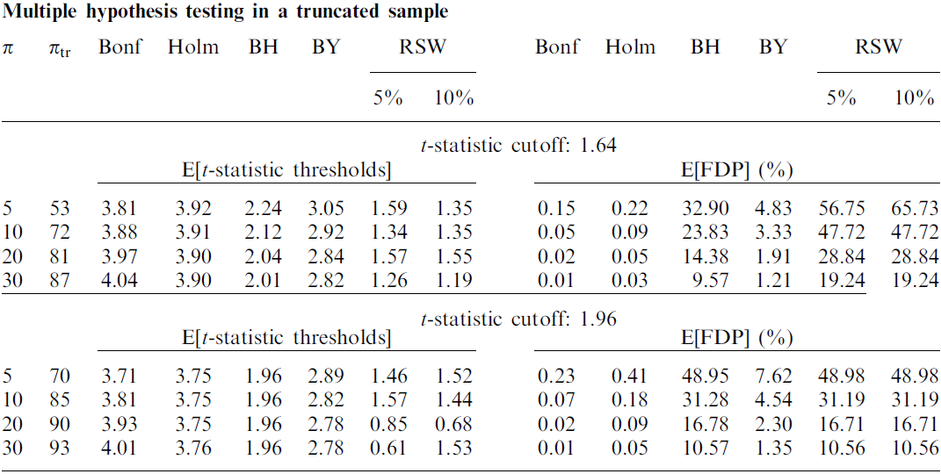
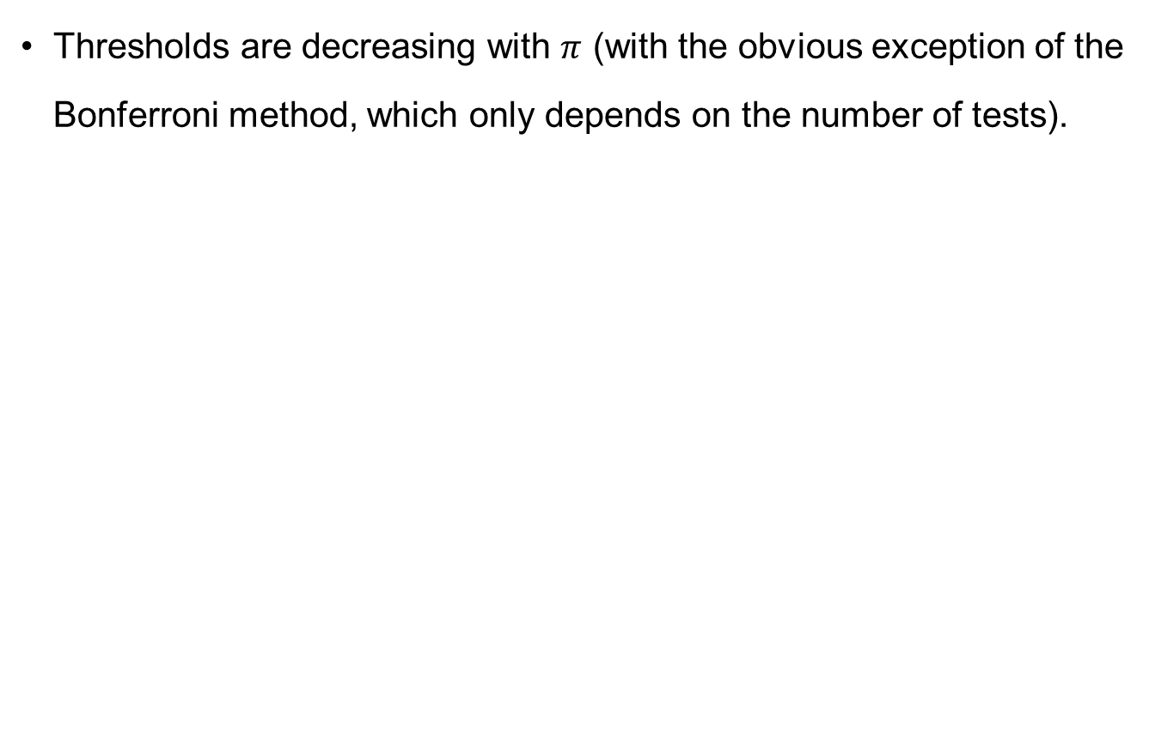
Publication bias
Thresholds are decreasing with $π$ (with the obvious exception of the Bonferroni method, which only depends on the number of tests).

Slide 37
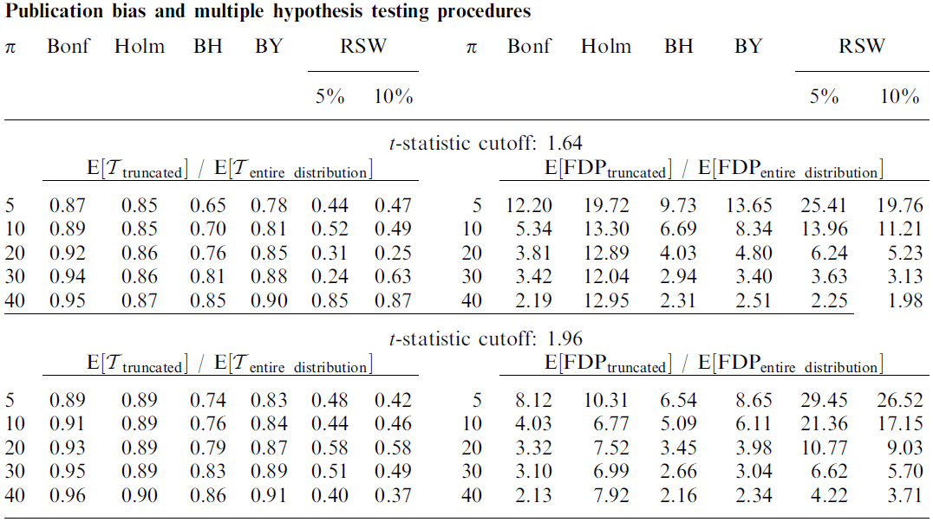
Publication bias
Thresholds are decreasing with $π$ (with the obvious exception of the Bonferroni method, which only depends on the number of tests).

Slide 38
Publication bias
In summary, the biases produced by considering only observable hypotheses and ignoring the file drawer problem are substantial, especially in the (likely) scenario there are only a small proportion of nonzero alphas compared to the large number of strategies tested.
Thus, in situations for which the sample of tests is truncated, a researcher must attempt to recover the missing part of the distribution before applying an MHT procedure to compute t-thresholds and determine the size of the false discovery problem.

Slide 39
Which Technique to Choose
From a practical point of view, the choice of a specific multiple testing adjustment is not easy or obvious. This is because the procedures presented above differ in fundamental ways because they implement different controls (i.e., FWER vs. FDR vs. FDP)
The number of tests, N, plays a critical role in the choice of the type of control. When N is very large, FWER control becomes very strict.
Many procedures control FWER. The choice of which to use will depend on which assumptions the researcher is willing to accept. Something as simple as Bonferroni, though, might be enough to rule out hypotheses that are only marginally significant.

Slide 40
Which Technique to Choose
Another important consideration is the dependence in the data. Situations in which tests are clearly not independent should be addressed in the context of an MHT technique that relies on resampling.
For example, the StepM procedure of Romano and Wolf (2005) and the FDP-StepM of Romano and Wolf (2007)would be a natural candidate to control FWER and FDP
FDR is the expected value of FDP, which one could read as an expectation across different samples. When the same hypothesis is tested in different countries or periods, the adoption of FDR control, which is generally speaking less strict than FDP, might be adequate

Slide 41
False Discoveries in Mutual Fund Performance: Measuring Luck in Estimated Alphas
Barras. L., Scaillet. O., Wermers.R.
The Journal of Finance, 2010.

Slide 42
Motivation
Recent papers indicate that some fund managers have stock selection skills. (Kosowski et al., 2006; Baks et al., 2001; P´astor and Stambaugh, 2002; Avramov and Wermers, 2006).
But they are not particularly informative regarding their prevalence in the entire fund population.
It is natural to wonder how many fund managers possess true stock-picking skills, and where these funds are located in the cross-sectional (estimated) alpha distribution.

Slide 43
Contribution
This paper implements a new approach to controlling for false discoveries in such a multiple fund setting.
Our approach estimates (1) the proportions of unskilled and skilled funds in the population and (2) their respective locations in the left and right tails of the cross-sectional estimated alpha.
Our approach to multiple testing is robustness to cross-sectional dependencies among fund estimated alphas.

Slide 44
Luck in a Multiple Fund Setting
Suppose that a population of M actively managed mutual funds is composed of three distinct performance categories
Unskilled funds: funds that have managers with stock-picking skills insufficient to recover their trading costs and expenses, creating an “alpha shortfall” (α < 0)
Zero-alpha funds: funds that have managers with stock-picking skills sufficient to just recover trading costs and expenses (α = 0)
Skilled funds: funds that have managers with stock-picking skills sufficient to provide an “alpha surplus,” beyond simply recovering trading costs and expenses (α > 0).

Slide 45
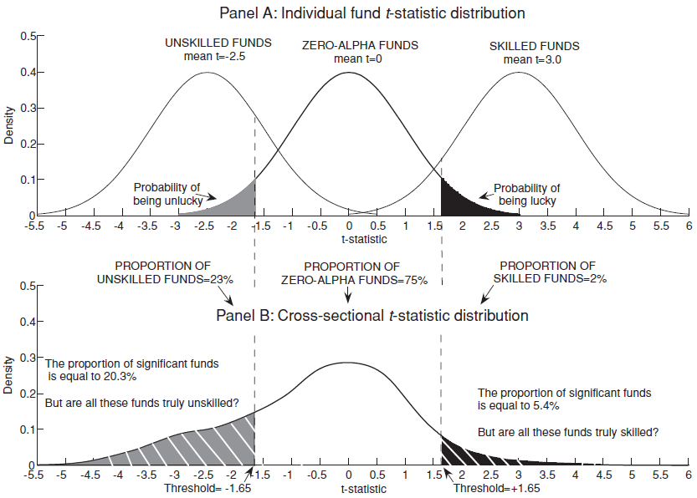
Measuring Luck

Slide 46
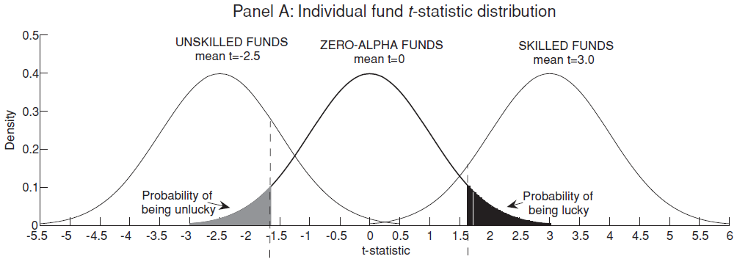
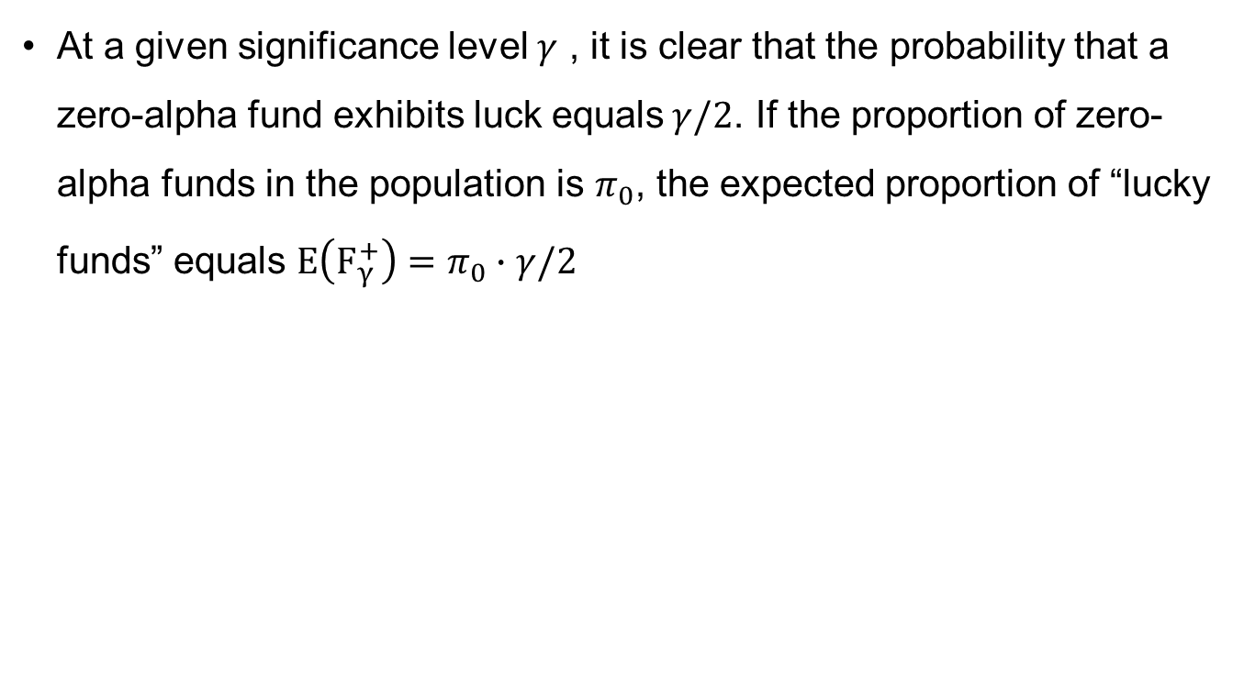
Measuring Luck
At a given significance level $γ$ , it is clear that the probability that a zero-alpha fund exhibits luck equals$γ/2$. If the proportion of zero-alpha funds in the population is $π_{0}$, the expected proportion of “lucky funds” equals $E\left(F_{γ}^{+}\right)=π_{0}∙$ $γ/2$

Slide 47
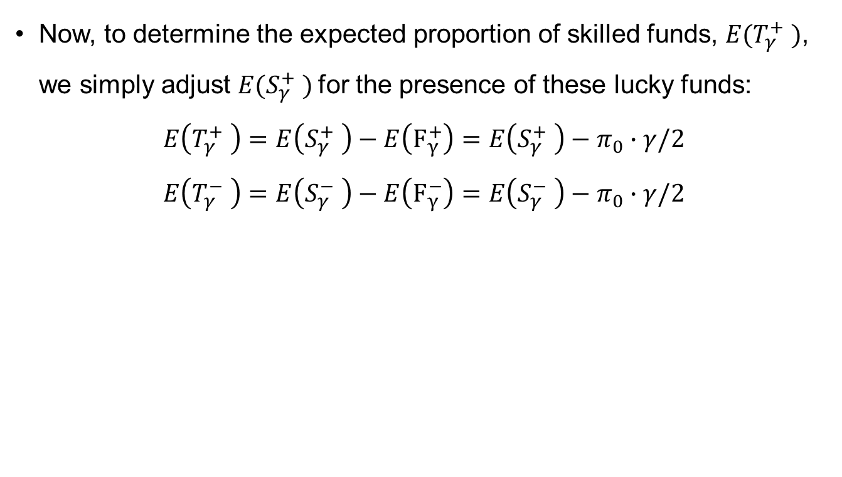
Measuring Luck
Now, to determine the expected proportion of skilled funds, $E(T_{γ}^{+} )$, we simply adjust $E(S_{γ}^{+} )$for the presence of these lucky funds:
$$E\left(T_{γ}^{+} \right)=E\left(S_{γ}^{+} \right)−E\left(F_{γ}^{+}\right)=E\left(S_{γ}^{+} \right)−π_{0}∙γ/2$$
$$E\left(T_{γ}^{−} \right)=E\left(S_{γ}^{−} \right)−E\left(F_{γ}^{−}\right)=E\left(S_{γ}^{−} \right)−π_{0}∙γ/2$$

Slide 48
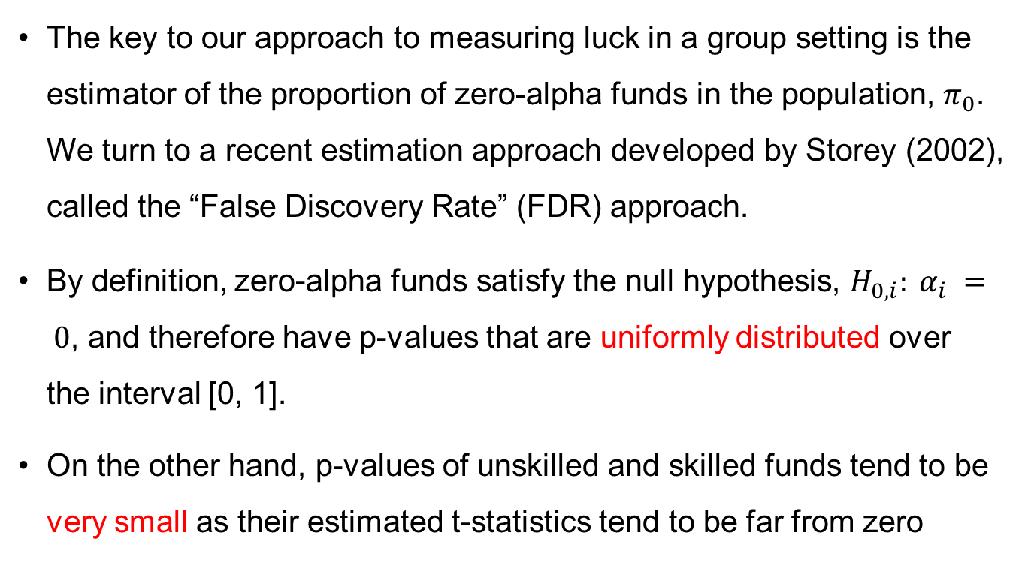
Estimation Procedure
The key to our approach to measuring luck in a group setting is the estimator of the proportion of zero-alpha funds in the population, $π_{0}$. We turn to a recent estimation approach developed by Storey (2002), called the “False Discovery Rate” (FDR) approach.
By definition, zero-alpha funds satisfy the null hypothesis, $H_{0,i}: α_{i} = 0$, and therefore have p-values that are uniformly distributed over the interval [0, 1].
On the other hand, p-values of unskilled and skilled funds tend to be very small as their estimated t-statistics tend to be far from zero

Slide 49
Estimation Procedure
The key to our approach to measuring luck in a group setting is the estimator of the proportion of zero-alpha funds in the population, $π_{0}$. We turn to a recent estimation approach developed by Storey (2002), called the “False Discovery Rate” (FDR) approach.
By definition, zero-alpha funds satisfy the null hypothesis, $H_{0,i}: α_{i} = 0$, and therefore have p-values that are uniformly distributed over the interval [0, 1].
On the other hand, p-values of unskilled and skilled funds tend to be very small as their estimated t-statistics tend to be far from zero

Slide 50
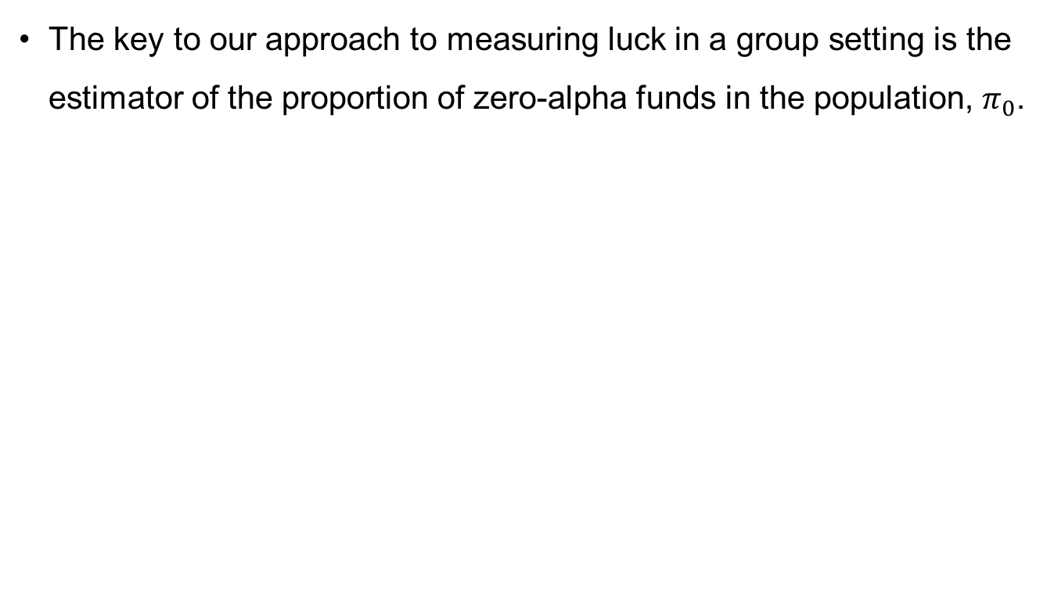
Estimation Procedure
The key to our approach to measuring luck in a group setting is the estimator of the proportion of zero-alpha funds in the population, $π_{0}$.
2076 funds

Slide 51
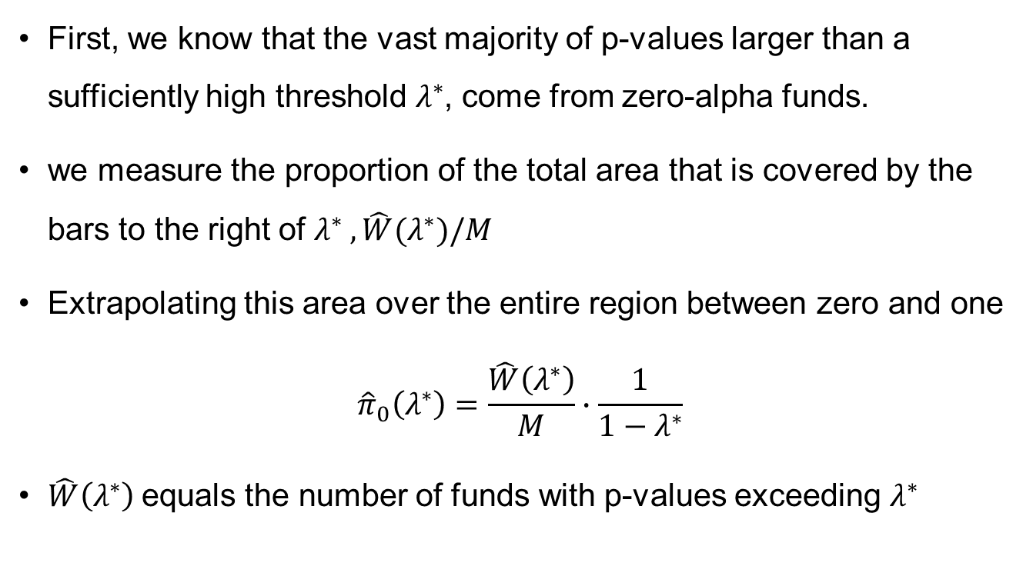
Estimation Procedure
First, we know that the vast majority of p-values larger than a sufficiently high threshold $λ^{∗}$, come from zero-alpha funds.
we measure the proportion of the total area that is covered by the bars to the right of $λ^{∗} , \hat{W}(λ^{∗})/M$
Extrapolating this area over the entire region between zero and one
$${\hat{π}}_{0}\left(λ^{∗}\right)=\frac{\hat{W}\left(λ^{∗}\right)}{M}∙\frac{1}{1−λ^{∗}}$$
$\hat{W}\left(λ^{∗}\right)$equals the number of funds with p-values exceeding $λ^{∗}$

Slide 52
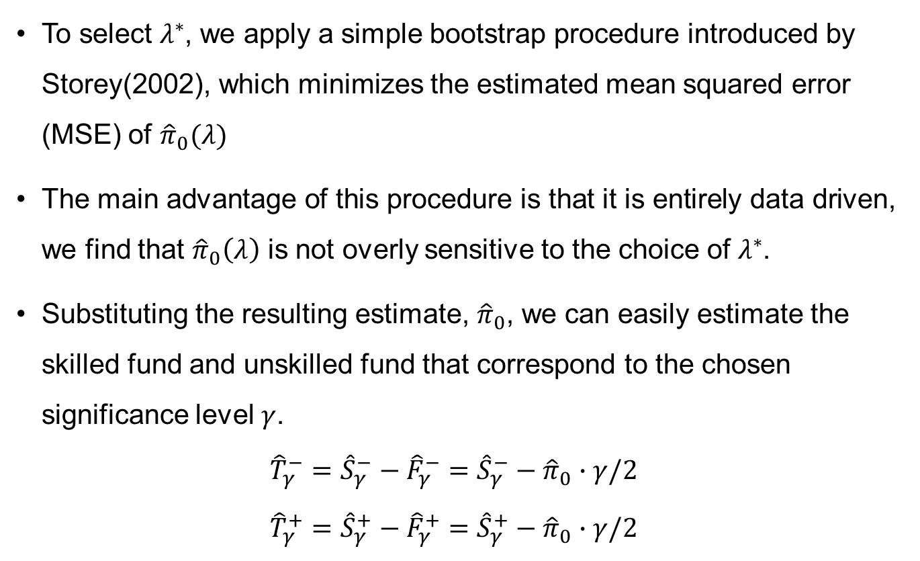
Estimation Procedure
To select $λ^{∗}$, we apply a simple bootstrap procedure introduced by Storey(2002), which minimizes the estimated mean squared error (MSE) of ${\hat{π}}_{0}(λ)$
The main advantage of this procedure is that it is entirely data driven, we find that ${\hat{π}}_{0}\left(λ\right)$ is not overly sensitive to the choice of $λ^{∗}$.
Substituting the resulting estimate, ${\hat{π}}_{0}$, we can easily estimate the skilled fund and unskilled fund that correspond to the chosen significance level$γ$.
$${\hat{T}}_{γ}^{−}={\hat{S}}_{γ}^{−}−{\hat{F}}_{γ}^{−}={\hat{S}}_{γ}^{−}−{\hat{π}}_{0}∙γ/2$$
$${\hat{T}}_{γ}^{+}={\hat{S}}_{γ}^{+}−{\hat{F}}_{γ}^{+}={\hat{S}}_{γ}^{+}−{\hat{π}}_{0}∙γ/2$$

Slide 53
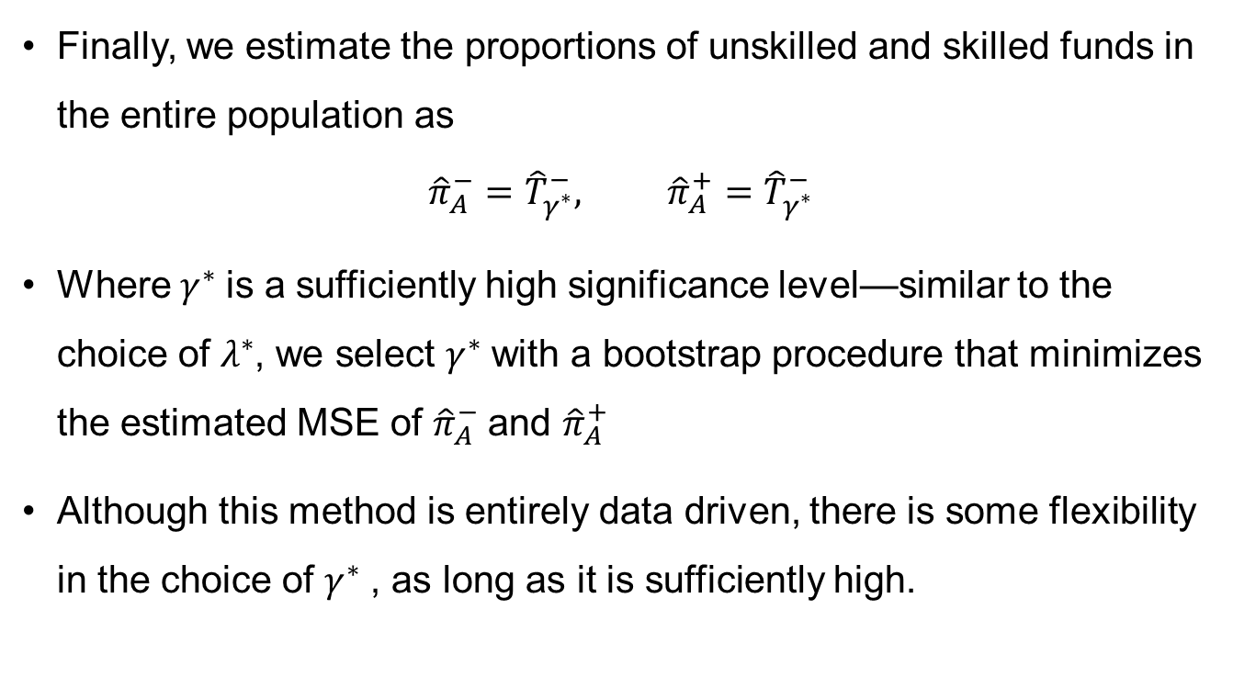
Estimation Procedure
Finally, we estimate the proportions of unskilled and skilled funds in the entire population as
$${\hat{π}}_{A}^{−}={\hat{T}}_{γ^{∗}}^{−}, {\hat{π}}_{A}^{+}={\hat{T}}_{γ^{∗}}^{−}$$
Where $γ^{∗}$is a sufficiently high significance level—similar to the choice of $λ^{∗}$, we select $γ^{∗}$with a bootstrap procedure that minimizes the estimated MSE of ${\hat{π}}_{A}^{−}$and ${\hat{π}}_{A}^{+}$
Although this method is entirely data driven, there is some flexibility in the choice of $γ^{∗}$, as long as it is sufficiently high.

Slide 54

Compare with Existing Methods
The previous literature has followed two alternative approaches when estimating the proportions of unskilled and skilled funds.
The “full luck” approach proposed by Jensen (1968) and Ferson and Qian (2004) assumes that all funds in the population have zero alphas $(π_{0} = 1).$(The proportions of lucky funds equal to$γ/2$)
At the other extreme, the “no luck” approach reports the observed number of significant funds (for instance, Ferson and Schadt (1996)) without making a correction for luck $(π_{0} = 0).$

Slide 55

Compare with Existing Methods

Slide 56
Cross-sectional Dependence
Mutual funds can have correlated residuals if they “herd” in their stockholdings (Wermers (1999)) or hold similar industry allocations.
An important advantage of our approach is that we estimate the p-value of each fund in isolation, avoiding the complications that arise because of the dependence structure of fund residuals. In our sample, we find that the average correlation between four-factor model residuals of pairs of funds is only 0.08. Further, many of our funds do not have highly overlapping return data, thus ruling out highly correlated residuals by construction.
However, in order to explicitly verify the properties of our estimators, we run a Monte Carlo simulation, both that average estimates (for all of our estimators) are very close to their true values

Slide 57

Asset Pricing Models
To compute fund performance, our baseline asset pricing model is the four factor model proposed by Carhart (1997):
$$r_{i,t}=α_{i}+b_{i}∙r_{m,t}+s_{i}∙r_{smb,t}+h_{i}∙r_{hml,t}+m_{i}∙r_{mom,t}+ε_{i,t}$$
We implement a conditional four-factor model to account for time varying exposure to the market portfolio (Ferson and Schadt (1996))
$$r_{i,t}=α_{i}+b_{i}∙r_{m,t}+s_{i}∙r_{smb,t}+h_{i}∙r_{hml,t}+m_{i}∙r_{mom,t}+B^{′}(z_{t−1}∙r_{m,t})+ε_{i,t}$$
where $z_{t−1}$denotes the J × 1 vector of predictive variables:1-month Tbill yield; dividend yield; the term spread; default spread

Slide 58
Data
We use monthly mutual fund return data provided by the CRSP between January 1975 and December 2006 to estimate fund alphas
The CRSP database is matched with the Thomson/CDA database using the MFLINKs product of Wharton Research Data Services in order to use Thomson fund investment objective information.
Our original sample is free of survivorship bias, but we further select only funds having at least 60 monthly return observations in order to obtain precise four factor alpha estimates.
Our final universe has 2,076 open-end, domestic equity mutual funds existing for at least 60 months between 1975 and 2006

Slide 59

Data
W e find that the unconditional and conditional estimated alphas for each category are negative.

Slide 60


Long-Term Performance
We begin our empirical analysis by measuring the impact of luck on long-term mutual fund performance, measured as the lifetime performance of each fund (over the period 1975 to 2006)
$${\hat{T}}_{γ}^{−}={\hat{S}}_{γ}^{−}−{\hat{F}}_{γ}^{−}={\hat{S}}_{γ}^{−}−{\hat{π}}_{0}∙γ/2$$
$${\hat{T}}_{γ}^{+}={\hat{S}}_{γ}^{+}−{\hat{F}}_{γ}^{+}={\hat{S}}_{γ}^{+}−{\hat{π}}_{0}∙γ/2$$

Slide 61

Long-Term Performance
we next examine the evolution of the long-term proportions of unskilled and skilled funds over time

Slide 62
Long-Term Performance
The proportion of funds with non-zero alphas (equal to the sum of the proportions of skilled and unskilled funds) remains fairly constant over time.
The proportion of skilled funds declines from 14.4% to 0.6%, while that of unskilled funds rises from 9.2% to 24.0% of the funds universe.
The growth of the fund industry has coincided with greater levels of stock market efficiency, making stock-picking more difficult and costly, or the large number of new managers simply have inadequate skills.

Slide 63

Short-Term Performance
To test for short run mutual fund performance, we partition our data into six non-overlapping subperiods of 5 years, beginning with 1977 to 1981 and ending with 2002 to 2006.

Slide 64

Short-Term Performance
Short-term superior performance is rare, but does exist, as opposed to long-term performance.
The short-term results are similar to the prior-discussed long-term results: the great majority of left tail funds are truly unskilled.
Proceeding toward the center of the distribution (by increasing γ to 0.10 and 0.20) produces almost no additional skilled funds, and almost entirely additional zero-alpha funds that are lucky $({\hat{F}}_{γ}^{+} )$

Slide 65
BG Model
We find evidence of short-term fund manager skills that disappear in the long term, it is interesting to further examine the mechanism through which skills disappear.
At the beginning of each (non-overlapping) 5-year period from 1977 to 2006, we rank funds into quintiles based on their
(1) size (total net assets under management)
(2) age (since first offered to the public)
(3) prior-year flows, as a percentage of total net assets.

Slide 66

BG Model

Slide 67
BG Model
The BG model implies that larger and older funds should exhibit lower alphas because they have presumably grown (or survived) to the point where they provide no superior alphas, net of fees—partly due to flows that followed past superior performance
Smaller and newer funds, on the other hand, may exhibit some skills before investors learn about their superior abilities
The highest flow quintile exhibits the highest proportion of skilled funds during the 5 years prior to the flow year, and the largest reduction in skilled funds during the 5 years subsequent to the flow year

Slide 68

Performance Persistence
Can we detect these skilled funds over time, in order to capture their superior alphas? Ideally, we would like to form a portfolio containing only the truly skilled funds in the right tail.
We explicitly account for the location of the skilled funds by using the False Discovery Rate in the right tail, $FDR^{+}.$
$$FDR^{+}=E\left(\frac{F_{γ}^{+}}{S_{γ}^{+}}\right)$$
Specifically, we set a sufficiently low significance level,$γ$, so as to include skilled funds along with a small number of zero-alpha funds that are extremely lucky.

Slide 69

Performance Persistence
Accordingly, we examine five $FDR^{+}$target levels, $z^{+}$, in our persistence test, namely, $z^{+}$ =10%,30%, 50%, 70%, and 90%. At the end of each year, we estimate the alpha p-values of each existing fund using the previous 5-year period.
$${\hat{FDR}}_{γ}^{+}=\frac{{\hat{F}}_{γ}^{+}}{{\hat{S}}_{γ}^{+}}=\frac{{\hat{π}}_{0}∙γ/2}{{\hat{S}}_{γ}^{+}}$$
For each $FDR^{+}$target level $z^{+}$, we determine the significance level, $γ (z^{+})$, only funds with p-values smaller than $γ (z^{+})$are included in an equally weighted portfolio. If a selected fund does not survive, its weight is reallocated to the remaining funds

Slide 70


Performance Persistence
Accordingly, we examine five $FDR^{+}$target levels, $z^{+}$, in our

Slide 71

Performance Persistence
We examine how the estimated alpha of the portfolio FDR10% evolves over time using expanding windows.

Slide 72

Additional Results
Performance Measured with Pre-expense Returns
Alternatively, skill could be defined in an absolute sense as the manager’s ability to produce a positive alpha before expenses are deducted.
Performance Measured with Other Asset Pricing Models
To examine the sensitivity of our results, we repeat the long-term (net of expense) performance analysis using the (unconditional) CAPM and Fama–French models.
Bayesian Interpretation
Although we operate in a classical frequentist framework, our new FDR measure, $FDR^{+},$also has a natural Bayesian interpretation

Slide 73

Pre-expense Returns
Only a small fraction of fund managers have stock picking skills that are insufficient to at least compensate for their trading costs

Slide 74


Other Asset Pricing Models
Based on the CAPM, we find that ${\hat{π}}_{A}^{−}$and ${\hat{π}}_{A}^{+}$ are equal to 14.3% and 8.6%, respectively, which is much more supportive of active management skills.
Turning to the Fama–French (1993)model, we find that ${\hat{π}}_{A}^{−}$and ${\hat{π}}_{A}^{+}$ amount to 25.0% and 1.7%, with only one factor is omitted.

Slide 75

Bayesian Interpretation
The Bayesian version of our $FDR^{+}$measure, denoted by $fdr_{γ}^{+}$.
$$fdr_{γ}^{+}=prob\left(G_{i}=0 \right|T_{i} ∈ Γ^{+}(γ )), where Γ^{+}(γ ) = (t_{γ}^{+} ,+∞)$$
$$fdr_{γ}^{+}=\frac{prob\left(T_{i} ∈ Γ^{+}(γ )\right|G_{i}=0)∙prob(G_{i}=0)}{prob(T_{i}∈ Γ^{+}(γ )) }=\frac{γ/2∙π_{0}}{E(S_{γ}^{+})}$$
Finally, we can also interpret the mutual fund selection from a Bayesian perspective. Following Storey (2003), the investor’s loss function, BE, can be written as a weighted average of each misclassification type:
$$BE\left(Γ^{+}\right)=\left(1−ψ\right)prob\left(T_{i}∈Γ^{+}\right)∙fdr_{γ}^{+}\left(Γ^{+}\right)+ψ∙prob(T_{i}∉Γ^{+})∙fnr_{γ}^{+}\left(Γ^{+}\right)$$
where $fnr_{γ}^{+}\left(Γ^{+}\right) = prob(G_{i} = +1 | Ti ∉Γ^{+})$is the “false nondiscovery rate” (i.e., the probability of failing to detect skilled funds)

Slide 76
Conclusion
In this paper, we apply a new method FDR approach for measuring the skills of fund managers in a group setting, we use these estimates to provide accurate counts of skilled funds within various intervals in both tail of the cross-sectional alpha distribution.
We apply the FDR technique to show that the proportion of skilled fund managers has diminished rapidly over the past 20 years
Our paper also shows that the long-standing puzzle of actively managed mutual fund underperformance is due to the long-term survival of a minority of truly underperforming funds.

Slide 77
Reassessing False Discoveries in Mutual Fund Performance:
Skill, Luck, or Lack of Power?
Andrikogiannopoulou. A., Papakomstantinou. F.
The Journal of Finance, 2019.

Slide 78
Overview
In this study, we reassess whether the FDR methodology can successfully distinguish skill from luck in mutual funds.
Expanding the simulation of BSW, we find that for data-generating processes (DGPs) that are informed by mutual fund data, the FDR estimator becomes markedly biased.
This bias arises from the fact that the pivotal assumptions behind the estimator fail due to the low signal-to-noise ratio in fund return data and the resulting lack of statistical power in tests of fund alpha

Slide 79

BSW Assumption
(i) The p-values corresponding to true nulls are independent and uniformly distributed on [0,1].
(ii) The p-values corresponding to the alternatives are near zero, one can estimate the proportion of true nulls as follows.
$${\hat{π}}_{0}\left(λ^{∗}\right)=\frac{\hat{W}\left(λ^{∗}\right)}{M}∙\frac{1}{1−λ^{∗}}$$

Slide 80
BSW Assumption
Although assumption (i) is relatively innocuous, assumption (ii) is quite strong and may easily fail.
The assumption (ii) of the FDR is equivalent here to assuming that nonzero alphas are sufficiently large or alpha is estimated with great precision.
This is unlikely to hold in the real data: not only is the true alpha distribution likely to have complex features, with some less extreme alphas, but we also know that the amount of information in fund returns varies widely across funds.

Slide 81
Research Design
We first investigate the sensitivity of the FDR estimates to variations in the distribution of fund alpha.
When we vary the proportions of funds with zero, negative, and positive alpha as well as the location and spread of the nonzero alphas, we find that as the proportion of zero-alpha funds gets smaller and nonzero alphas become less extreme
The FDR estimator becomes inaccurate: the point estimates are far from the true values and their confidence intervals rarely contain the true proportions.

Slide 82
Research Design
Next, we explore how the number of observations, and hence the amount of information, in the data affects the FDR estimator.
On the one hand, we find that the number of funds has no effect on the estimator’s accuracy, as it affects neither the power of each individual test nor the distribution of alpha p-values in the sample.
On the other hand, we find that the number of observations per fund has a strong effect, but convergence to the true proportions can be very slow as this number increases

Slide 83
Research Design
Finally, we study the effect that cross-sectional correlation in fund return errors has on the FDR estimator.
We find that error correlation increases the estimator’s variability by a factor of five. This means that even if alphas are large and the FDR estimator is unbiased, it will often be far from the truth.

Slide 84

FDR Review
The FDR methodology proceeds in three steps. First, it estimates the proportion π0 of true nulls (funds with zero alpha) as
$${\hat{π}}_{0}\left(λ^{∗}\right)=\frac{\hat{W}\left(λ^{∗}\right)}{M}∙\frac{1}{1−λ^{∗}}$$
Next, given this estimate${\hat{π}}_{0}\left(λ\right)$, the proportion of nulls that are expected to be falsely rejected at any significance level $γ ∈ (0, 1)$can be calculated as ${\hat{π}}_{0}∙γ$
Finally, for a significance level $γ ≤ λ$high enough that the null hypothesis is rejected for all alternatives
$${\hat{T}}_{γ}^{−}={\hat{S}}_{γ}^{−}−{\hat{F}}_{γ}^{−}={\hat{S}}_{γ}^{−}−{\hat{π}}_{0}∙γ/2$$
$${\hat{T}}_{γ}^{+}={\hat{S}}_{γ}^{+}−{\hat{F}}_{γ}^{+}={\hat{S}}_{γ}^{+}−{\hat{π}}_{0}∙γ/2$$

Slide 85

Alpha Distribution
Under the second distribution, in contrast, some nonzero alphas are closer to zero, with about a quarter of p-values above λ belonging to nonzero-alpha funds
75% mass at α = 0
23% mass at α = −3.2%
2% mass at α = 3.8%
45% mass at α = 0
27.5% mass at α > 0
27.5% mass at α < 0

Slide 86

Simulation Setup
Model of Returns: We generate samples of fund returns according to the linear factor model
$$r_{it}=α_{i}+F_{t}^{′}β_{i}+ε_{it} (3)$$
Mutual Fund Data: To select plausible simulation parameters, we use the same mutual fund data sources and apply the same data filters as BSW.
Simulation Parameters: we generate a balanced panel of fund returns with cross-sectional dimension N = 1,400 and time-series dimension equal to the total number of months in the data (T = 384).

Slide 87
Simulation Setup
This distribution’s parameters are chosen as follows. Initially, the FDR approach is applied to the real data at the end of each year from 2002 to 2006, using all funds’ returns up to that point.
Next, the proportions of zero-, negative-, and positive-alpha funds are set to the mean estimated proportions. The location of the nonzero alphas is then calibrated to be consistent with these proportions.
Finally, the errors are assumed to be homogeneous homoscedastic, and cross-sectionally independent

Slide 88

Variation in DGP for Alpha
In our first simulations, we generate alphas from a discrete distribution with three point masses $(δ^{0}, δ_{\overline{α} }^{−} and δ_{\overline{α}}^{+}),$that is
$$\begin{aligned}α\sim {π^{0}δ}^{0}+π^{−}δ_{\overline{α} }^{−}+π^{+} δ_{\overline{α}}^{+}\#\#\#\#\left(4\right)\end{aligned}$$
Then we examine the estimator’s sensitivity to alternative alpha DGPs in which we vary both the proportions of fund types and the distribution (location and spread) of nonzero alphas.
Specifically, we vary $π_{0}$ from 93.75% to 6.25%, keeping the ratio $π^{−}/π^{+}$equal to 11.5 (as in BSW), and we vary $\overline{α}$ from 1% to 3.5% per year.

Slide 89

Variation in DGP for Alpha
Each cell of the table is shaded, with darker (lighter) shades corresponding to more (less) biased estimates.

Slide 90

Variation in DGP for Alpha
As a consequence of the FDR estimator’s bias, the resulting confidence intervals can become highly misleading

Slide 91

Variation in DGP for Alpha
We see that for the DGP similar to that used in the BSW simulations, that is, for $π^{0}$ = 75%, $π^{−}$= 23%, $π^{+}$ = 2%, and $\overline{α}$ = 3.5%, the FDR yields proportions (76.3%, 21.4%, and 2.3%, respectively) close to the true proportions.
The FDR becomes biased, however, as the proportion of zero-alpha funds decreases and nonzero alphas become less extreme but remain economically large.

Slide 92

No-luck approach comparison
We see that for the DGP similar to that used in the BSW

Slide 93

Normal Nonzero Alphas
Next, we generate fund alphas from a mixture of a point mass at zero and a normal distribution, that is,
$$α\sim {π^{0}δ}^{0}+{(π}^{−}+π^{+})f_{Ν(μ_{α},σ_{α}^{2})}$$
This specification is important as it nests the distributions estimated by some studies in the literature (e.g., Jones and Shanken (2005), Fama and French (2010))
Motivated by recent studies that suggest that the distribution of fund alpha may be fat-tailed (Sastry (2015), Andrikogiannopoulou and Papakonstantinou (2016)), we also examine the sensitivity of the FDR estimators to fat tails by simulating nonzero alphas from a t distribution

Slide 94

Normal Nonzero Alphas
Next, we generate fund alphas from a mixture of a point mass at

Slide 95

Variation in Sample Size
We see that increasing N has virtually no effect on the bias in the FDR estimator, while increasing T makes the estimates more accurate.

Slide 96

Unbalanced Panel
The bias is more pronounced in the presence of an unbalanced panel with a shorter average time series dimension.

Slide 97

Cross-Sectional Error Correlation
Specifically, BSW replace the assumption $ε_{it}∼N (0, σ^{2})$in equation (3) with a latent linear factor structure intended to capture the role of nonpriced factors. In particular
$$ε_{it}=G_{t}δ+G_{t}^{−}δI_{α_{i}=−\overline{α}}+G_{t}^{+}δI_{α_{i}=\overline{α}}+ξ_{it}$$
$ξ_{it}∼N(0, σ^{∗2})$is the cross-sectionally independent part of the error.
Here, we replace the assumption $ε_{it}∼N \left(0, σ^{2}\right)with ε_{it}:= G_{t}^{′}δ_{i} + ξ_{it}$
$ξ_{it}∼N(0, σ_{i}^{∗2} )$ with $σ_{i}^{∗}$ a fund-specific standard deviation

Slide 98


Cross-Sectional Error Correlation
We find that the FDR estimator’s bias is unaffected but its variability is greatly increased in the presence of this correlation.

Slide 99
Conclusions
While the FDR methodology can be advantageous in some settings, it needs to be applied with caution
We find that the FDR performs poorly under certain conditions, and that the accuracy found in past simulations in the mutual fund setting can be traced to potentially unrealistic simulation assumptions
Fund alphas follow a discrete distribution with point masses very far from zero
There are a large number of observations per fund
There is no or limited cross-sectional correlation across funds.
Overall, our results indicate that the FDR approach is unlikely to offer a substantial improvement over simpler methodologies.

Slide 100
False (and Missed) Discoveries in
Financial Economics
Harvey. C., Liu. Y.
Journal of Finance, 2019.

Slide 101
Motivation
Given the difficulty in determining the Type II error rate, current multiple testing adjustments often focus only on Type I errors.
Whether these methods have good performance in terms of Type I error rates and what the implied Type II error rates would be thus remain open questions.
Assumptions become increasingly untenable when we have a large collection of tests(cross-sectional dependence).
When there are multiple tests, even the definitions of Type I and Type II error rates become less straightforward as it may be more consistent with the manager’s objective function.

Slide 102



Type I and II Error

Slide 103
Test Power
Why is test power important for research in financial economics?
On the one hand, when a study’s main finding is the nonexistence of an effect, test power directly affects the credibility of the finding because it determines the probability of not rejecting the null hypothesis when the effect is true
On the other hand, when the main finding is the rejection of the null hypothesis, this finding often has to survive against alternative hypotheses. Low test power for alternative explanations generates a high Type I error rate for the main hypothesis

Slide 104
Research Design
First, we introduce a framework that offers an intuitive definition of test power.
Second, we employ a double-bootstrap approach that can flexibly (i.e., specific to a particular data set) estimate test power.
Finally, we illustrate how taking test power into account can materially change our interpretation of important research findings in the current literature.

Slide 105





Testing outcomes

Slide 106

Bootstrapped Error Rates
Suppose we have $N$ strategies and $D$ time periods. We arrange the data into a $D×N$data matrix $X_{0}$. Suppose one believes that a fraction $p_{0}$of the $N$ strategies are true.
Although the choice of $p_{0}$ is inherently subjective, we offer several guidelines as to the selection of an appropriate $p_{0}$.
First, examination of the summary statistics for the data can help narrow the range of reasonable priors.
Second, it may be a good idea to apply prior knowledge to elicit $p_{0}$.
Finally, we present a simulation framework that helps gauge the potential loss from applying different priors.

Slide 107

Fama and French (2010)
Fama and French (2010) subtracted the in-sample alpha estimate from each fund’s return to generate a “pseudo” sample of funds whose alphas are precisely zero. Let this sample be $Y_{0}$.
Then bootstrapping $Y_{0}$ to generate distributions of the cross section of t-statistics and compare these bootstrapped distributions to the actual distribution to draw inferences, if the null hypothesis is (falsely) rejected, then take the average rejection rate as the Type I error rate.
More specifically, we bootstrap the time periods to perturb $Y_{0}$. This is where our approach departs from Fama and French (2010)—while they make a one shot decision for $Y_{0}$

Slide 108

Double Bootstrap
Bootstrap the time periods and let the bootstrapped panel of returns be $X_{i}$. For $X_{i}$, obtain the corresponding $1×N$vector of t-statistics$t_{i}$.
Rank the components in $t_{i}$. For the top $p_{0}$ of strategies in $t_{i}$, find the corresponding strategies in the original data $X_{0}$. Adjust these strategies so they have the same means as those for the top $p_{0}$ of strategies ranked by $t_{i}$ in $X_{i}$. (denote the data matrix for the adjusted strategies by $X_{0,1}^{\left(i\right)}$). For the remaining strategies in $X_{0}$, adjust them so they have zero mean in-sample (denote the corresponding data matrix by $X_{0,0}^{\left(i\right)}$). Arrange $X_{0,1}^{\left(i\right)}$ and $X_{0,0}^{\left(i\right)}$into a new data matrix $Y_{i}$.

Slide 109

Double Bootstrap
Bootstrap the time periods J times. For each bootstrapped sample, calculate the realized error rates (or odds ratio) for $Y_{i}$, denoted by $f_{i,j}$($f$stands for a generic error rate that is a function of the testing outcomes).
Repeat Steps I to III I times. Calculate the final bootstrapped error rate
$$\frac{1}{IJ}\sum_{i=1}^{I}{\sum_{j=1}^{J}{f_{i,j}}}$$

Slide 110

Type I & II error rate
By joining $X_{1,0}^{(i)}$with $X_{0,0}^{(i)}$, we obtain a new panel. For $Y_{0}$, we perform the Fama-French (2010) approach and let the testing outcome be given by $h_{i}$, where $h_{i}$ is equal to one if we reject the null hypothesis and zero otherwise. Finally, we perturb $Y_{0}$ many times and calculate the empirical Type I error rate (i.e., $TYPE1_{ff}$) as the average $h_{i}$.
Using this panel, we apply the Fama-French (2010) approach and record the testing outcome as $l_{i}=1$if the null hypothesis is not rejected (and zero otherwise). The empirical Type II error rate (i.e., $TYPE2_{ff}$) is then calculated as the average $l_{i}$.

Slide 111
Applications
We illustrate how our method can be used to select outperforming strategies and we compare our method to existing multiple-testing techniques.
In the first, we study two large groups of investment strategies.
We start with Standard and Poor’s Capital IQ (CAPIQ) database, which covers a broad set of “alpha” strategies. For our purposes, we study 484 strategies for the U.S. equity market from 1985 to 2014.
The second data set comprises the 18,113 anomalies based on firm characteristics studied in Yan and Zheng (2017).
Our second application revisits Fama and French’s (2010) conclusion about mutual fund performance.

Slide 112

Applications
For the CAPIQ data, the distribution is skewed to the right. For the 18,000 anomalies, the distribution is roughly symmetric around zero and the fraction of strategies that have t-statistic above 2.0 is 5.5%.

Slide 113

Applications
 | Yes预测 | No预测 | 合计
Yes实际 | TP | FN | P
No实际 | FP | TN | N
We illustrate how our method can be used to create the receiver operating characteristic (ROC) curve, which is an intuitive diagnostic plot to assess the performance of a classification method
TPR = TP/P
FPR = FP/N

Slide 114


Having a Prior on $p_{0}$
We first apply our method to study how the Type I and Type II error rates vary across different t-statistic thresholds. In practice, researchers often use a predetermined t-statistic threshold

Slide 115

Having a Prior on $p_{0}$
the classic trade-off between Type I and Type II error rates in single hypothesis tests continues to hold in a multiple testing framework. The odds ratio also decreases as the threshold t-statistic increases.

Slide 116
Applications
The overall message of Figure 2 is that two elements need to be taken into account to select the best strategies. One is investors’ prior on the fraction of true strategies.
The other element needed to select the best strategies relates to the particular data at hand and the hypothesis that is being tested.
Our bootstrap-based framework generates t-statistic thresholds that are calibrated to the particular decision being considered and the particular data under analysis.
Our view is that we should incorporate our prior beliefs into decision-making process, as doing so helps us make informed decisions based on the trade-off between the Type I and Type II errors.

Slide 117
Applications
The overall message of Figure 2 is that two elements need to be taken into account to select the best strategies. One is investors’ prior on the fraction of true strategies.
The other element needed to select the best strategies relates to the particular data at hand and the hypothesis that is being tested.
Our bootstrap-based framework generates t-statistic thresholds that are calibrated to the particular decision being considered and the particular data under analysis.
Our view is that we should incorporate our prior beliefs into decision-making process, as doing so helps us make informed decisions based on the trade-off between the Type I and Type II errors.

Slide 118


Applications
The cutoff t-statistic declines as $p_{0}$ becomes larger, since a discovery is less likely to be false when a larger fraction of strategies are true

Slide 119

Comparison: CAPIQ
Given our focus on the FDR, we implement popular multiple-testing adjustments proposed in the literatures that aim to control the FDR.

Slide 120


Comparison: 18,000 Anomalies
BH generally performs worse than the three Storey tests in controlling the FDR when $p_{0}$is not too large.

Slide 121
Revisiting Yan and Zheng (2017)
Our results suggest that only about 0.1% (or 18) of the 18,000 anomaly strategies in Yan and Zheng (2017) are classified as “true” to control the FDR at 10%. Why are our results so different from those of Yan and Zheng (2017)?
Yan and Zheng (2017) are interested in finding an unbiased estimate of the fraction of true discoveries, multiple-testing adjustments seek to control the FDR at a certain level, and many true strategies will be missed when the hurdle is high
More specifically, we show that the Fama-French (2010) approach is not designed to estimate the fraction of true strategies, which focuses only on whether the entire population of strategies has a zero mean return

Slide 122


Revisiting Yan and Zheng (2017)
Let $Frac_{d}$ be the $(1−d)th$percentile of the cross section of t-statistics. Define $Frac$ as the maximum D in (0,0.4) such that $p(Frac_{d})≤0.05$is true for all $d∈(0,D).$ Table IV reports summary statistics on Frac for different levels of $p_{0}$

Slide 123


Unknown $p_{0}$
When $p_{0}$ is unknown, we focus on the ability of our method to correctly rank the performance of existing methods. We conduct our simulation study using the CAPIQ data.
There are several advantages to modeling the cross-sectional distribution F with a Gamma distribution
We focus on one-sided tests in this section, so F should have positive support.
Moments are available analytically, so we can easily change the mean (variance) while holding the variance (mean) constant to study the comparative statics.
Finally, a Gamma distribution has higher moment characteristics (e.g., skewness and excess kurtosis) that allow it to capture salient features of F

Slide 124


Gamma distribution
Overall, our method presents a substantial improvement over the usual approach that takes the stated significance level as given. Our results show that Est. is often much closer to Actual than $δ$.

Slide 125
Performance Evaluation
Our mutual fund data are obtained from the CRSP Mutual Fund database. We apply similar screening procedures to Fama and French (2010) to obtain our data set.
Our data start from January 1984 to mitigate omission bias (Elton et al., 2001) and end in December 2006 to be consistent with Fama and French (2010).
Limit tests to funds with AUM of at least five million dollars in 2006 terms—once a fund passes this size threshold, its subsequent returns are included in our tests
Require at least eight monthly return observations to be included in our tests.
Restrict our sample to funds that appear on CRSP at least five years before the end of the sample period to avoid funds that have a short return history.

Slide 126

Performance Evaluation
Compared to the t-statistic distribution for the CAPIQ data in Figure 1, the fraction of funds with large and positive t-statistic is much smaller.

Slide 127

Performance Evaluation
In particular, we reexamine the question of whether there exist any outperforming funds.
More specifically, we use our double-bootstrap approach to evaluate the Type I and Type II error rates for the single-bootstrap approach proposed by Fama and French (2010).
While $p_{0}$ captures the prior belief about the fraction of skilled managers, it does not tell us the magnitude of the average alpha across these managers. We therefore calculate two additional statistics that help gauge the economic significance of the alphas generated by outperforming funds.

Slide 128

Performance Evaluation

Slide 129

Are There Outperforming Funds?
Since the undersampling of funds with a relatively short sample period contributes to the low test power of the Fama and French (2010) approach, the methods we explore in this section all boil down to the question of which funds to drop to alleviate the issue of undersampling.
For the full-sample analysis similar to Fama and French (2010), we explore two specifications for the threshold $t: T = 36 and T = 60$. For the subsample analysis, we focus on five-year subsamples and require complete data for each subsample

Slide 130

Are There Outperforming Funds?
Since the undersampling of funds with a relatively short sample period contributes to the low test power of the Fama and French

Slide 131

Are There Outperforming Funds?
We find strong evidence for outperforming funds in the early part of the sample

Slide 132
Asset Pricing with Omitted Factors
Giglio. S., Xiu. D.
Working Paper, 2019.

Slide 133
Motivation
Standard estimators of risk premia in linear asset pricing models are biased if some priced factors are omitted.
How to propose a method to estimate the risk premium of an observable factor, which is valid even when not all factors in the model are specified or observed?
There is, however, no theoretical guarantee that the controls or the spanning portfolios are adequate to correct the omitted variable bias.

Slide 134
Contribution
We introduce a new three-pass methodology that exploits (i) the large dimensionality of available test assets, and (ii) a rotation invariance result, to correctly recover the risk premium of any observable factor, even when not all true risk factors are observed and included in the model

Slide 135

Standard Risk Premia Estimators
Suppose that $v_{t}=(v_{1t}:v_{2t})$is a vector of two potentially correlated factors. Assuming that the risk-free rate is observed, we express the model in terms of excess returns:
$$r_{t} = βγ + βv_{t} + u_{t}$$
Two-pass regressions estimate the factor risk premia as follows.
First, time series regressions of each test asset’s excess return onto the factors estimate the assets’ risk exposures, $β_{1} and β_{2}$.
Second, a cross-sectional regression of average returns onto the estimated $β_{1} and β_{2}$ yields the risk premia estimates of $γ_{1} and γ_{2}$.

Slide 136

Omitted Variable Bias
Consider the projection of $g_{t}=v_{1t}$onto the excess returns of a chosen set of test assets, ${\breve{r}}_{t}$
$w_{g} =\frac{Cov\left({\breve{r}}_{t}, g_{t}\right)}{Var\left({\breve{r}}_{t}\right)}$ $r_{t}^{g}={\left(w_{g}\right)}^{T}{\breve{r}}_{t} {\breve{r}}_{t}= \breve{β}γ +\breve{β}v_{t} + u_{t}$
$γ_{g}^{MP}={\left(w_{g}\right)}^{T}E\left({\breve{r}}_{t}\right)={\left\{{\left(\breve{β}Σ^{v}{\breve{β}}^{T}+{\breve{Σ}}^{u}\right)}^{−1}\left(\breve{β}Σ^{v}e_{1}\right)\right\}}^{T}\breve{β}γ$
If the assets are chosen to be $p$ portfolios that (a) are well diversified (so that ${\breve{Σ}}^{u}≈ 0$), and (b) fully span the true factors $v_{t}$, so that $\breve{β}$ is invertible and $v_{t}={\breve{β}}^{−1}{\breve{r}}_{t}$
If both conditions hold, we indeed have $γ_{g}^{MP}=γ_{1}$

Slide 137

Measurement Error Bias
Suppose that the econometrician can only observe $g_{t}=v_{1t}+z_{t}$, where $z_{t}$ is measurement error orthogonal to the factors, but potentially correlated with $u_{t}$. Measurement error in $g_{t}$adds another source of bias to the standard estimators.
$γ_{g}^{MP}={\left(w_{g}\right)}^{T}E\left({\breve{r}}_{t}\right)={\left\{{\left(\breve{β}Σ^{v}{\breve{β}}^{T}+{\breve{Σ}}^{u}\right)}^{−1}\left(\breve{β}Σ^{v}e_{1}+{\breve{Σ}}^{z,u}\right)\right\}}^{T}\breve{β}γ≠γ_{1}$
Thus, measurement error $z_{t}$can introduce a bias in the mimicking-portfolio estimator, unless idiosyncratic errors ${\breve{u}}_{t}$in the spanning assets are uncorrelated with $z_{t}$.

Slide 138

Methodology
In this section we present our three-pass risk premia estimator, which tackles both the omitted variable and measurement error biases in estimating risk premia in linear factor models.
$$r_{t} = βγ + βv_{t} + u_{t}$$
Call $g_{t}$ a set of d observable (tradable or nontradable) factors whose risk premia we aim to estimate. $g_{t}$ is related to the factors $v_{t}$ as follows
$g_{t}=δ+ηv_{t}+z_{t}, E\left(z_{t}\right)=0, and Cov(z_{t}, v_{t})=0$
Where $η$ captures the relation between $g_{t}$ and the unobservable factors $v_{t}$, and $z_{t}$ is measurement error in $g_{t}$

Slide 139

Rotation Invariance
the product $ηγ$ can be identified even if one only observes an arbitrary full-rank rotation of the factors: that is, if one just observes ${\hat{v}}_{t}=Hv_{t}$, with $H$ any full-rank $p × p$matrix, but does neither observe $v_{t}$ nor $H$
To see that, rewrite the model as:
$$r_{t}=βH^{−1}Hγ+βH^{−1}Hv_{t}+u_{t}$$
$$g_{t}=δ+ηH^{−1}Hv_{t}+z_{t}$$
Where $η$ captures the relation between $g_{t}$ and the unobservable factors $v_{t}$, and $z_{t}$ is measurement error in $g_{t}$.
$$r_{t}=\hat{β}\hat{γ}+\hat{β}{\hat{v}}_{t}+u_{t}$$
$$g_{t}=δ+\hat{η}{\hat{v}}_{t}+z_{t}$$

Slide 140

Rotation Invariance
As long as $v_{t}$is observed, we can then identify $\hat{η}= ηH^{−1}$(it is the vector of regression coefficients of $g_{t}$ on ${\hat{v}}_{t}$), as well as $\hat{γ}= Hγ$
While we clearly cannot recover $η or γ$separately because we do not know$H$, we can still identify the risk premium of $g_{t}$, because:
$$\hat{η}\hat{γ}=ηH^{−1}Hγ=ηγ=γ_{g}$$
estimates the rotated factors ${\hat{v}}_{t}$via PCA;
estimates via a two-pass cross-sectional regressionas $\hat{γ}= Hγ$,
estimates $\hat{η}=ηH^{−1}$via a time-series regression of $g_{t}$ onto the estimated ${\hat{v}}_{t}$.

Slide 141


The Three-Pass Estimator
We now present our three-pass estimator. We denote R as the n × T matrix of excess returns, V the p × T matrix of factors, G the d × T matrix of observable factors, U the n × T matrix of idiosyncratic errors and Z the d × T matrix of measurement error.
$$R=βγι_{T}^{′}+βV+U$$

Slide 142

The Three-Pass Estimator

Slide 143

Asymptotic Theory

Slide 144

Asymptotic Theory

Slide 145

Asymptotic Theory

Slide 146
Thousands of Alpha
Giglio. S., Liu. Y., Xiao. D.
The Review of Financial Studies, 2020.

Slide 147
Motivation
Data snooping is a major concern in empirical asset pricing. With multiple testing comes the concern that as more tests are performed, an increasing number of them will be positive purely due to chance.
Anomalies potentially have exposures to unknown risk factors and fund managers may trade common factors that are not observable.
Many time series of returns have short histories or missing records, and these returns likely follow a factor model.
Contrary to the case of mutual funds, for which net alpha is estimated to be zero or negative for the vast majority of funds, there is more evidence that some hedge funds are able to generate alpha.

Slide 148
Existing Literatures
The existing literature in asset pricing is aware of the data-snooping concern with multiple testing (e.g., Lo and MacKinlay 1990) and has taken in response two alternative approaches.
One has been to abandon the multiple-testing problem altogether: to ask whether any fund beats the benchmark, or whether funds on average beat the benchmark (see, e.g., White 2000; Kosowski et al. 2006; Fama and French 2010)
The second approach, proposed by Barras et al. (2010), Bajgrowicz and Scaillet (2012), Harvey et al. (2015),etc., imports statistical methods that directly control the family-wise error rate or the false discovery rate, however, facing omitting factors and missing data.

Slide 149
Methodology
Our framework is based on a combination of three key ingredients: factor analysis, Fama-MacBeth regressions, and false discovery control.
In a first step, we use time-series regressions to estimate fund exposures to (observable) benchmark factors. We further apply PCA or matrix completion to residuals to recover the missing commonalities.
Next, we implement cross-sectional regressions like Fama-MacBeth to estimate the risk premiums of the factors and the alphas relative to the augmented benchmark model.
Finally, we build t-statistics for these alphas and apply the B-H procedure for the FDR control.

Slide 150

Model Setup
We begin with a description of the model. We assume the $N×1$vector of excess returns$r_{t}$follows
$$r_{t} = α+βλ+β(f_{t}−E(f_{t}))+u_{t}$$
Where $f_{t}$ is a $K×1$vector of factors and $u_{t}$is the idiosyncratic component. The parameter $λ$is a $K×1$vector of factor risk premiums
The objective is to find individual funds with truly positive alphas.
$$H_{0}^{i}:α_{i}≤0, i=1, …, N. H_{0}^{i}:α_{i}=0, i=1, …, N.$$
$$GRS test: H_{0}:α_{1}=α_{2}=…=α_{N}=0$$
The former is a multiple-testing problem that addresses which funds have significantly positive alphas. In contrast, the latter addresses whether there exists (at least one) fund whose alpha is significantly different from zero.

Slide 151

Model Setup
We begin with a description of the model. We assume the $N×1$vector of excess returns$r_{t}$follows
$$r_{t} = α+βλ+β(f_{t}−E(f_{t}))+u_{t}$$
Where $f_{t}$ is a $K×1$vector of factors and $u_{t}$is the idiosyncratic component. The parameter $λ$is a $K×1$vector of factor risk premiums
The objective is to find individual funds with truly positive alphas.
$$H_{0}^{i}:α_{i}≤0, i=1, …, N. H_{0}^{i}:α_{i}=0, i=1, …, N.$$
$$GRS test: H_{0}:α_{1}=α_{2}=…=α_{N}=0$$
The former is a multiple-testing problem that addresses which funds have significantly positive alphas. In contrast, the latter addresses whether there exists (at least one) fund whose alpha is significantly different from zero.

Slide 152

Model Setup
The possibility that many of the tests will look significant by pure chance, even if their true alpha is zero.
For example, suppose there are 1,000 funds available, with only 10% of them having positive alphas. Conducting 1,000 tests independently would yield $1000×(1−10\%)×5\% = 45$false positive alphas, in addition to $1000×10\%=100$true positive alphas
Consequently, among the $100+45=145 "$skilled" fund managers we find, almost one-third of them are purely due to luck.

Slide 153

Controlling FDR
Let $H_{0}⊂\{1,…, N\}$denote the set of indices for which the corresponding null hypotheses are true, $R$ be the total number of rejections in a sample, and let $F$ be the number of false rejections in that sample:
$$F=\sum_{i=1}^{N}{1\left\{i≤N:t_{i}>c_{i} and i ∈H_{0}\right\}, } R=\sum_{i=1}^{N}{1\left\{i≤N:t_{i}>c_{i}\right\}, }$$
In a specific sample, we can obviously observe $R$, but we cannot observe $F$. we write the FDP and its expectation, FDR, as
$$FDP=\frac{F}{\max\left\{R,1\right\}}, FDR=E(FDP)$$
For comparison, we can also write the per-test error rate, $E(F)/N$, and the $FWER, P(F≥1)≤τ$

Slide 154
B-H procedure
The FDR control procedure strikes a balance between these two approaches. It accepts a certain number of false discoveries as the price to pay to gain power in detecting true rejections.
Algorithm 1(B-H procedure) Let $N_{0}$ be the num. of true null hypotheses.
We still do not know $N_{0}$, so we replace it with some upper bound $M$
$$F\left(p\right)\begin{matrix}\left(a\right) \\ ≈\end{matrix}N_{0}P\left(p_{i}<p | α_{i}≤0\right)\begin{matrix}\left(b\right) \\ ≤\end{matrix}N_{0}P\left(p_{i}<p | α_{i}=0\right)\begin{matrix}\left(c\right) \\ =\end{matrix}N_{0}p≈Mp$$
$$p≤\frac{τR\left(p\right)}{M}=\frac{τ\sum_{i=1}^{N}{1\left\{i≤N:p_{i}>p\right\}}}{M}$$
$$p^{∗}=max\left\{p∈\left(0,1\right):p≤\frac{τ\sum_{i=1}^{N}{1\left\{i≤N:p_{i}>p\right\}}}{M}\right\}$$

Slide 155

B-H procedure
Based on the above discussion, not surprisingly, the count of negative alphas adversely affects the power of the B-H procedure.
$$F\left(p\right)\begin{matrix}\left(a\right) \\ ≈\end{matrix}N_{0}P\left(p_{i}<p | α_{i}≤0\right)\begin{matrix}\left(b\right) \\ ≤\end{matrix}N_{0}P\left(p_{i}<p | α_{i}=0\right)\begin{matrix}\left(c\right) \\ =\end{matrix}N_{0}p≈Mp$$
Holding the number of non-negative alphas constant, as the count of negative alphas increases, the critical value $τ\hat{k}=N$shrinks
We tackle this problem by using a simple dimension reduction technique, the screening method in the context of testing for inequalities.
The idea is that when some of the alphas are “overwhelmingly negative" their corresponding hypotheses could be simply eliminated from the set of candidate hypotheses

Slide 156

Alpha Screening
Based on the above discussion, not surprisingly, the count of negative alphas adversely affects the power of the B-H procedure.
$$F\left(p\right)\begin{matrix}\left(a\right) \\ ≈\end{matrix}N_{0}P\left(p_{i}<p | α_{i}≤0\right)\begin{matrix}\left(b\right) \\ ≤\end{matrix}N_{0}P\left(p_{i}<p | α_{i}=0\right)\begin{matrix}\left(c\right) \\ =\end{matrix}N_{0}p≈Mp$$
Holding the number of non-negative alphas constant, as the count of negative alphas increases, the critical value $τ\hat{k}=N$shrinks
We tackle this problem by using a simple dimension reduction technique, the screening method in the context of testing for inequalities.

Slide 157

Alpha Screening
The idea is that when some of the alphas are “overwhelmingly negative" their corresponding hypotheses could be simply eliminated from the set of candidate hypotheses.
This would reduce the total count of hypotheses and thereby improve the power of FDR control. Based on this idea, we propose to reduce the set of funds to
$$\hat{I}=\left\{i≤N:t_{i}>log⁡(log⁡T)\sqrt{logN}\right\}$$
Where the threshold depends on the sample size and the cross-sectional dimension. We thereby can safely consider a smaller set of funds $\hat{I}$for FDR control.

Slide 158

Compare with BSW(2010)
Alternatively, Barras et al. (2010) apply a simple adjustment proposed by Storey (2002) to improve the power of the B-H procedure.
Specifically, they suggest replacing $\hat{k}τ=N$in the cutoff value by $\hat{k}τ=N_{0}$, where $N_{0}$is the number of true null hypotheses that can be estimated using ${\hat{N}}_{0}={\left(1−λ\right)}^{−1}\sum_{i=1}^{N}{\left\{p_{i}>λ\right\}}$, where $λ∈(0,1)$ is a tuning parameter.
Therefore one would expect $N_{0}(1−λ)$of the p-values to lie within the interval $(λ,1)$for any sufficiently large $λ$. Replacing $N with N_{0}<N$thereby increases the power of the procedure.
However, this adjustment is not applicable in the context of testing null hypotheses that are inequalities, under which the p-values are no longer uniformly distributed.

Slide 159
Compare with others
By eliminating the true negatives, the remaining null alphas are close to zero, so that we can safely increase the critical value, and consequently enhance the power of the procedure.
In a setting similar to ours, Harvey and Liu (2018) propose to increase statistical power by dropping funds that appear only for a small number of periods.
This approach shares the same spirit as our alpha screening step and is typically used in the literature (e.g., Fung and Hsieh (1997) require at least 36 months of data).

Slide 160
Estimating alpha
When the benchmark includes non-tradable factors, estimating Equation (1) requires two-pass Fama-MacBeth regressions.
The first stage estimates using time-series regressions of individual fund returns onto the benchmark factors, and the second stage involves a cross-sectional regression of average returns onto the estimated, where the residuals of this regression yield estimates of alpha, denoted as b

Slide 161


Estimating obstacles
When the benchmark includes non-tradable factors, estimating Equation (1) requires two-pass Fama-MacBeth regressions.
As long as the latent factors in $f_{l}$ contribute to the total risk premiums, then a bias $β_{l}λ_{l}$ would arise in the estimated “alpha“. Even if $f_{l}$ is not priced, omitting $f_{l}$ would still lead to an omitted variable bias for when $f_{l}$ is correlated with $f_{o}$.
Secondly, $f_{l}$plays the role of “idiosyncratic" error.
Thirdly, leaving $f_{l}$in the residuals produces strong correlation among the alpha test statistics, which invalidates the independence assumption.

Slide 162

Observable factors only
When all factors are observable (not necessarily tradable), we can directly estimate using the classical two-pass regression
S1a. Run time-series regressions and obtain the OLS estimator $β$
$$\hat{β}=\left(RM_{1_{T}}F^{′}\right){\left(FM_{1_{T}}F^{′}\right)}^{−1}$$
S2. Run a cross-sectional regression of $\overline{r}$ on the estimated $\hat{β}$to obtain $\hat{λ}$
$$\hat{λ}={\left({\hat{β}}^{′}M_{1_{N}}\hat{β}\right)}^{−1}\left({\hat{β}}^{′}M_{1_{N}}\overline{r}\right)$$
S3. Estimate the estimated risk premiums from average returns: $\hat{α}=\overline{r}−\hat{β}\hat{λ}$

Slide 163

Latent factors only
In the case that some factors are missing from an observable factor model, the first-step time-series regressions are no longer consistent.
In this case, we follow Giglio and Xiu (2017) and proceed by rewriting Equation(1) into a statistical factor model:
$$\overline{R}=β\overline{V}+\overline{U}$$
Simply replacing S1a in Algorithm 3 with S1b below leads to a new algorithm for estimating in this scenario:
S1b. Let $S_{R}=\frac{1}{T}\overline{R}{\overline{R}}^{′}$be the $N×N$ sample covariance matrix of $R$. Conduct the principal component analysis of $S_{R}$:

Slide 164
Latent factors only
In the case that some factors are missing from an observable factor model, the first-step time-series regressions are no longer consistent.
In this case, we follow Giglio and Xiu (2017) and proceed by rewriting Equation(1) into a statistical factor model:
$$\overline{R}=β\overline{V}+\overline{U}$$
Simply replacing S1a in Algorithm 3 with S1b below leads to a new algorithm for estimating in this scenario:
S1b. Let $S_{R}=\frac{1}{T}\overline{R}{\overline{R}}^{′}$be the $N×N$ sample covariance matrix of $R$. Conduct the principal component analysis of $S_{R}$:

Slide 165

Latent factors only
S1b. Let $S_{R}=\frac{1}{T}\overline{R}{\overline{R}}^{′}$be the $N×N$ sample covariance matrix of $R$. Conduct the principal component analysis of $S_{R}$: set
$$\hat{β}=\sqrt{N}(b1,…, b_{K})$$
where $b_{1},…, b_{K}$are the $K$ eigenvectors of $S_{R}$, corresponding to its largest $K$ eigenvalues.
S2 & S3 are the same as in Algorithm 3.
This procedure therefore uses the principal components of returns as factors and uses them as a benchmark to estimate the alphas.

Slide 166


General case
We now present the most general case, where $f_{o,t}$is a $K_{o}×1$vector of observable factors, and $f_{l,t}$ is a $K_{l}×1$vector of latent factors,
To estimate in this case, we combine S1a and S1b, and then proceed with S2 and S3 as in Algorithm 3.
Specifically, we first obtain ${\hat{β}}_{o}$ from time-series regressions using observable factors alone, and then obtain ${\hat{β}}_{l}$ by applying PCA to the covariance matrix of residuals from time-series regressions. The estimated ${\hat{β}}_{o}$ and ${\hat{β}}_{l}$ are stacked together as $\hat{β}$.

Slide 167

General case
S1.a. Run time-series regressions and obtain the OLS estimator ${\hat{β}}_{o}$ and residual matrix Z, where $F_{o}=(f_{o,1}, f_{o,2},…, f_{o,T}):$
$${\hat{β}}_{o}=\left(RM_{1_{T}}F_{o}^{′}\right){\left(F_{o}M_{1_{T}}F_{o}^{′}\right)}^{−1}, Z=\overline{R}−{\hat{β}}_{o}−{\overline{F}}_{o}$$
S1. b. Let $S_{Z}=\frac{1}{T}ZZ^{′}$be the $N×N$sample covariance matrix of$Z$. Let
$${\hat{β}}_{l}=\sqrt{N}(b1,…, b_{K_{l}})$$
where $b_{1},…, b_{K_{l}}$are the $K_{l}$ eigenvectors of $S_{Z}$, corresponding to its largest $K_{l}$ eigenvalues. The resulting $\hat{β}$ is given by
$$\hat{β}=({\hat{β}}_{o}, {\hat{β}}_{l})$$

Slide 168

General case
The presence of such bias does not affect the inference for alphas, thanks to the invariance of alpha to the rotation of the factors
Formally, we can show that ${\hat{β}}_{o}\underset{→}{P}β_{o}+β_{l}H_{1}$for some matrix $H_{1}$, where $β_{l}H_{1}$ denotes the omitted variable bias. Hence the probability limit of $β_{o}$ is still spanned by $β=\left(β_{o},β_{l}\right).$ As a result, we have established that
$$\hat{β}=({\hat{β}}_{o}, {\hat{β}}_{l})\underset{→}{P}βH$$
The resulting alpha estimate remains consistent because it is invariant to rotations (the rotation matrix $H$ is canceled with its inverse in $\hat{λ}$) and is thus not affected by the omitted variable bias.

Slide 169
Dealing with missing data
It is not uncommon in finance applications to deal with unbalanced panels. Many hedge funds last for short periods of time, then liquidate, and many new funds pop up.
It is therefore important that the estimators we propose work in the presence of missing data. We adopt the matrix completion method from the recent machine learning literature.
A notable application of this method is the so-called Netflix problem in predicting customers' ratings of movies based on existing ratings. The key assumption behind this algorithm is that the full matrix is approximately low-rank.

Slide 170
Dealing with missing data
It is not uncommon in finance applications to deal with unbalanced panels. Many hedge funds last for short periods of time, then liquidate, and many new funds pop up.
It is therefore important that the estimators we propose work in the presence of missing data. We adopt the matrix completion method from the recent machine learning literature.
A notable application of this method is the so-called Netflix problem in predicting customers' ratings of movies based on existing ratings.

Slide 171

Dealing with missing data
When data are missing, the common approach in the literature is to adopt an EM algorithm (e.g., Stock and Watson 2002; Su et al. 2019).
In contrast, our matrix completion approach is much faster; hence it is particularly appealing for large dimensional return matrices.
The key assumption behind this algorithm is that the full matrix is approximately low-rank.
The goal is to recover an $N×T$ low-rank matrix $X$. Suppose that Z is an $N×T$ matrix (the “noisy version" of $X$), which can be written as $Z=X+E$, and $E$ is the noise.

Slide 172

Matrix completion
Suppose $Z$ is not fully observed and $Ω$ is an $N×T$ matrix whose $(i, t)$-th element $ω_{it}=1\left\{z_{it} \text{is} \text{observed}\right\}$.
Using this notation, econometricians can only observe $Z ° Ω$and $Ω$, where $°$represents the element-wise matrix product.
We employ the following nuclear-norm penalized regression approach to recover $X$:
$$\begin{aligned}\hat{X}=arg \min_{X}{{\left|\left|\left(Z−X\right) ° Ω\right|\right|}^{2}+λ_{NT}{\left|\left|X\right|\right|}_{n}}\#\left(16\right)\end{aligned}$$
${\left|\left|X\right|\right|}_{n}$ denotes the matrix nuclear norm and $λ_{NT}> 0$ is a tuning parameter. By penalizing the singular values of X, the algorithm achieves a low-rank matrix as the output. The latent factors and betas can then be estimated via the associated singular vectors of $\hat{X}$

Slide 173

Matrix completion
Let $N_{t}$ denote the set of funds that are observed at time$t$and $T_{i}$ denote the collection of time points on which the $i−th$ fund return is observed:
$N_{t}=\left\{i∈\left\{1, …, N\right\}:r_{it} is observed\right\}, T_{i}=\left\{t∈\left\{1, …, T\right\}:r_{it} is observed\right\}$
We first estimate an observable factor models to calculate the residual matrix Z
S1. a. Obtain ${\hat{β}}_{o}$and the residual matrix $Z={\left(z_{it}\right)}_{N×T}$:
$${\hat{β}}_{o,i}={\left(F_{o,i}M_{1_{T_{i}}}F_{o,i}^{′}\right)}^{−1}\left(F_{o,i}M_{1_{T}}R_{i}\right)$$
$z_{it}=r_{it}−{\overline{r}}_{i}−{\hat{β}}_{o,i}^{′}\left(f_{o,t}−{\overline{f}}_{o,t}\right)$ $r_{it}$ is observable; otherwise $z_{it}$ is missing.
S1. b. Conduct matrix completion, with $Z$ in Equation (16) constructed above, and obtain a low-rank matrix $\hat{X}$

Slide 174

Matrix completion
Estimate the latent factors and their loadings using $\hat{X}$:
$${\hat{v}}_{l,t}={\left(\sum_{i∈N_{t}}{b_{i}b_{i}^{′}}\right)}^{−1}\sum_{i∈N_{t}}{b_{i}z_{it}}, t=1,…, T$$
$${\hat{β}}_{l,t}={\left(\sum_{i∈T_{i}}{{\hat{v}}_{l,t}{\hat{v}}_{l,t}^{′}}\right)}^{−1}\sum_{i∈T_{i}}{{\hat{v}}_{l,t}z_{it}}, i=1,…, N$$
Where $b_{1},…, b_{K_{l}}$is the top $K_{l}$ left singular-vectors of $\hat{X}$
The resulting $\hat{β}$ is given by $\hat{β}=\left({\hat{β}}_{o}, {\hat{β}}_{l}\right)$ and the factors ${\hat{v}}_{t}={\left(f_{o,t}−{\overline{f}}_{o},{\hat{v}}_{l,t}^{′}\right)}^{′}$, where ${\overline{f}}_{o}=\frac{1}{T}\sum_{t=1}^{T}{f_{o,t}}$
S2 is the same as in Algorithm 3 with inputs $\hat{β}$ from above and ${\overline{r}}_{i}$, which yields the estimate $\hat{λ}$

Slide 175


Matrix completion
Estimate the latent factors and their loadings using $\hat{X}$:

Slide 176
Matrix completion
Estimate the latent factors and their loadings using $\hat{X}$:

Slide 177


Bootstrapping p-values
S0. Generate a bootstrap sample of $r_{it}^{∗}$by resampling weighted residuals:
$$r_{it}^{∗}={\hat{β}}_{i}^{′}\hat{λ}+{\hat{β}}_{i}^{′}{\hat{v}}_{t}+{\hat{u}}_{it}^{∗}, {\hat{u}}_{it}^{∗}={\hat{u}}_{it}w_{it}, for t∈T_{i}$$
where $\left\{w_{it}:i≤N, t≤T\right\}$is a sequence of $i.i.d.$ random variables, satisfying $E(w_{it})=0$and $Var\left(w_{it}\right)=1$

Slide 178

Simulation
With respect to the data-generating process, we consider a five-factor model for hedge fund returns.
To examine the impact of missing data on our procedures, we also resample the exact missing pattern of these funds. Throughout the simulations, we fix T = 240 and N = 1000, and on average over 70% of all records are missing.
We vary the simulated cross-sectional distribution of alphas to check the performance of the FDR, we simulate the alphas from a mixture of two Gaussian distributions, $N(−2σ; σ^{2}) and N(2σ; σ^{2})$, with mixture probabilities p1 and p2, plus a point mass at zero.

Slide 179

Simulation
The figure plots the histograms of the standardized alpha estimates for one fixed fund using Algorithms 3 ,4 (latent factors only), and 5 (mixture),

Slide 180

Simulation

Slide 181
Simulation
First of all, we find it critical to use alpha tests that take into account omitted factors, by comparing columns c and d with column b.
Second, comparing columns d and e, we find alpha screening less conservative and more powerful, when the unskilled funds p1, is large.
Third, the standard bootstrap method in various scenarios does not cope well with missing data and missing factors.
Fourth, columns b, h, i, and j clearly show that missing a factor tends to increase the standard errors of the FDP.
Finally, without any B-H type control, the false discovery rate can exceed 35% among the experiments we consider even in the most ideal setting

Slide 182
Hedge fund returns data
We apply our methodology to the Lipper TASS hedge funds data set, covering the time period 1994-2018. We follow closely the bias correction and data-cleaning procedures of Sinclair (2018)
As is standard in this literature, we only focus on funds that have a sufficiently long time series. Based on our simulations, we choose a minimum period of 36 months

Slide 183
Benchmark model
We consider two standard benchmark models. Our baseline model will be the Fung and Hsieh (2004)seven-factor model.
The model includes market, size, a bond factor, a credit risk factor, and three trend-following factors(related to bonds, currencies & commodities).
As an alternative, we also consider the Agarwal and Naik (2004) model
Which includes the Fama-French-Carhart four factors (market, size, value, and momentum factors) plus two option-based factors (an out-of-the-money call and an out-of-the-money put factor).

Slide 184

Hedge fund returns data
To get a sense of the factor structure of hedge fund returns, the blue line in panel B of Figure 2 shows the first 15 eigenvalues of the excess returns in our panel.

Slide 185

In-sample analysis
We begin with an in-sample analysis in which we compare the funds selected by our FDR control methodology to those selected using different methodologies.

Slide 186

Out-of-sample analysis
We begin with an in-sample analysis in which we compare the funds selected by our FDR control methodology to those selected using different methodologies.

Slide 187
Out-of-sample analysis
We begin with an in-sample analysis in which we compare the funds selected by our FDR control methodology to those selected using different methodologies.

Slide 188
Out-of-sample analysis
We begin with an in-sample analysis in which we compare the funds selected by our FDR control methodology to those selected using different methodologies.

